Slide 1
Competitive Solar Incentive (CSI) Program
Stakeholder Meeting #2
May 26, 2022

Slide 2
Welcome
This is the second public stakeholder meeting for
Docket # QO21101186
Competitive Solar Incentive (“CSI”) Program
pursuant to P.L. 2021, C.169

Slide 3
Covered in this meeting
This meeting will focus on the following parts of the CSI Straw Proposal released on April 26, 2022:
Section IV.A - Solicitation tranches
Section IV.A - Implementation of the “Grid Supply Solar Paired with Storage” tranche
Section IV.C - Auction procedure
Section IV.F - Procurement frequency

Slide 4
Webinar Instruction Page
All attendees will be automatically muted
Questions? Please use the “Q &A” function in Zoom
We will address clarifying questions at the end of each section
Please note that the “Chat” function in Zoom is not available for this meeting
This meeting is being recorded. A copy of the recording and slides will be made available on the BPU website: https://www.nj.gov/bpu/newsroom/public/

Slide 5
Disclaimer
This presentation is provided for informational purposes only and should not be taken to represent the views of the New Jersey Board of Public Utilities, its Commissioners, or the State of New Jersey. Please be aware that any information presented is subject to change if there are changes to New Jersey statutes, rules, or policies.
All viewers are responsible for ensuring that they rely only on current legal authority regarding the matters covered in the presentation.

Slide 6
Written Stakeholder Comment Guidelines
The deadline for comments on the Siting Straw is 5:00 p.m. ET on Monday, June 20, 2022
Please submit comments directly to Docket No. QO21101186, using the “Post Comments” button on the Board’s Public Document Search tool.
Comments are considered “public documents” for purposes of the State’s Open Public Records Act and any confidential information should be submitted in accordance with the procedures set forth in N.J.A.C. 14:1-12.3.
Written comments may also be submitted to:
Carmen D. Diaz
Acting Secretary of the Board
44 South Clinton Avenue, 1st Floor
Post Office Box 350
Trenton, NJ 08625-0350
Phone: 609-292-1599
Email: board.secretary@bpu.nj.gov

Slide 7
Competitive Solar Incentive (CSI) Program Stakeholder Meeting
Session #2 – Straw Proposal
May 26, 2022

Slide 8
Summary of Process
Initial Stakeholder Session (Nov. 30, 2021)
Straw Proposal (April 26, 2022)
3 Stakeholder Meetings (May 26, June 1, and June 6, 2022)
Written Comments (due June 20, 2022)
Daymark report to the Board
Board Order & Proposed Rules
First Solicitation
Board establishes Successor Solar Incentive Program (July 28, 2021)
Today, May 26 Meeting

Slide 9
Topics of Today’s Discussion
Bid tranche definitions
Establishing separate competitive project categories
Solar + Storage
Proposed method for incentivizing inclusion of storage with solar
Auction procedure
Order of project category evaluation
Procurement frequency
How often new projects can enter the competitive process

Slide 10
Topic 1: Bid Tranche Definitions

Slide 11
Proposed Tranches
Purpose of Tranches
Proposed Tranches
Separation of tranches allows like-projects to compete on even footing where one single pool would disadvantage some projects with preferred attributes.
Basic grid supply
Grid supply on built environment
Grid supply on contaminated land and landfills
Net metered non-residential projects above 5 MW
Storage paired with grid supply

Slide 12
Tranche 1: Basic Grid Supply Definition
All solar projects directly connected to the New Jersey grid are eligible
Proposed Definition: Basic Grid Supply Projects include all grid supply solar projects that do not qualify for Tranches 2 or 3 and are connected to the distribution or transmission system owned or operated by a New Jersey public utility or local government unit.

Slide 13
Tranche 1: Basic Grid Supply Detail
In this tranche, projects will be required to comply with all applicable solar siting regulations (see solar siting Straw Proposal)

Slide 14
Tranche 2: Grid Supply on the Built Environment Definition
Projects on rooftops
Proposed Definition: Grid Supply on the Built Environment refers to all grid supply solar projects for which 100% of the photovoltaic panels are installed on rooftops, raised carports over parking lots or parking decks, or similar installations on the built environment, and connected to the distribution or transmission system owned or operated by a New Jersey public utility or local government unit.
Projects on raised carports over parking lots

Slide 15
Tranche 2: Grid Supply on the Built Environment Detail
Policy direction towards projects on the Built Environment (Solar Act of 2021*)
Price will be determined by bids received (potentially subject to a price cap)
*N.J.S.A §48:3-117(4)(c)

Slide 16
Tranche 3: Grid Supply on Contaminated Sites Definition
Projects on contaminated sites
Proposed Definition: ‘Contaminated site or landfill’ means: (1) any currently contaminated portion of a property on which industrial or commercial operations were conducted and a discharge occurred, and its associated disturbed areas, where ‘discharge’ means the same as the term defined in section 23 of P.L.1993, c.139 (C.58:10B-1) or (2) a properly closed sanitary landfill facility and its associated disturbed areas.
Associated disturbed areas will include areas, which may themselves not have been contaminated, but are clearly associated with contaminated areas or landfills. Examples include access roads, lay-down areas and former building sites that were previously part of an industrial or landfill complex. The associated disturbed areas cannot exceed 10% of the total land area targeted for solar development.
Projects on landfills

Slide 17
Tranche 3: Grid Supply on Contaminated Sites Detail
Distinct tranche due to specific costs of mitigation and permitting
Tranche recognized in Solar Act of 2021 for environmental and public health benefits
Building on New Jersey’s strong legacy of landfill and brownfield development previously supported under the subsection (t) program

Slide 18
Tranche 4: Net Metered Non-residential Projects Definition
Net metered non-residential projects larger than 5 MW
Proposed Definition: Net metered non-residential projects larger than 5 MW must meet the requirements of their New Jersey utility to qualify as net-metered projects serving non-residential customers

Slide 19
Tranche 4: Net Metered Non-residential Projects Detail
Net metered projects already receive subsidy in form of net metered credits, which may inherently advantage net metered projects against standard grid supply
Providing their own tranche maintains balance of program and encourages multiple formats of grid-scale solar
No preference between different types of sites being developed within the net metered tranche (i.e., the Straw does not include additional preference for contaminated sites or built environment projects)

Slide 20
Topic 2: Solar + Storage

Slide 21
Tranche 5: Storage Paired with Grid Supply
Storage paired with any solar eligible for the CSI Program
Proposed Definition: Storage Paired with Grid Supply Solar is any project that qualifies to participate in Tranches 1, 2, or 3 and which includes a battery storage unit that meets PJM’s definition of either a co-located or hybrid storage resource (in the case of co-located storage, pre-qualification must include evidence of separate PJM queue status).

Slide 22
Tranche 5: Storage Paired with Grid Supply Detail
New Jersey currently has no independent energy storage incentive program
Clean Energy Act (P.L.2018, c.17.) specifies a goal of 2000 MW of storage by 2030
CSI Storage tranche will support the deployment of large-scale solar + storage and provide price discovery
Creating separate tranche ensures that bids which elect to include storage can participate equally in the selection process for solar
Projects cannot claim SREC-IIs in excess of total MWh power generated by associated solar generation

Slide 23
Creating a Competitive Storage SREC-II Adder
Solar project evaluated independently in its own tranche
Only if the associated solar project is selected, the associated storage project is then evaluated independently in storage tranche
Outcome of storage tranche is a competitive storage adder, which will be added to the SREC-II value derived from the solar tranche

Slide 24
Storage adder implementation for actual projects
SREC-IIs are created based on the MWhs produced by the solar facility ($/MWh)
The storage adder will be additional $/MWh amount added to the SREC-II value
Projects can be eligible for a storage adder with any MWh quantity of storage
The final storage adder will be proportional to the amount of storage relative to the project
Projects with less than 100% 4-hour storage match will get a proportionally smaller adder

Slide 25
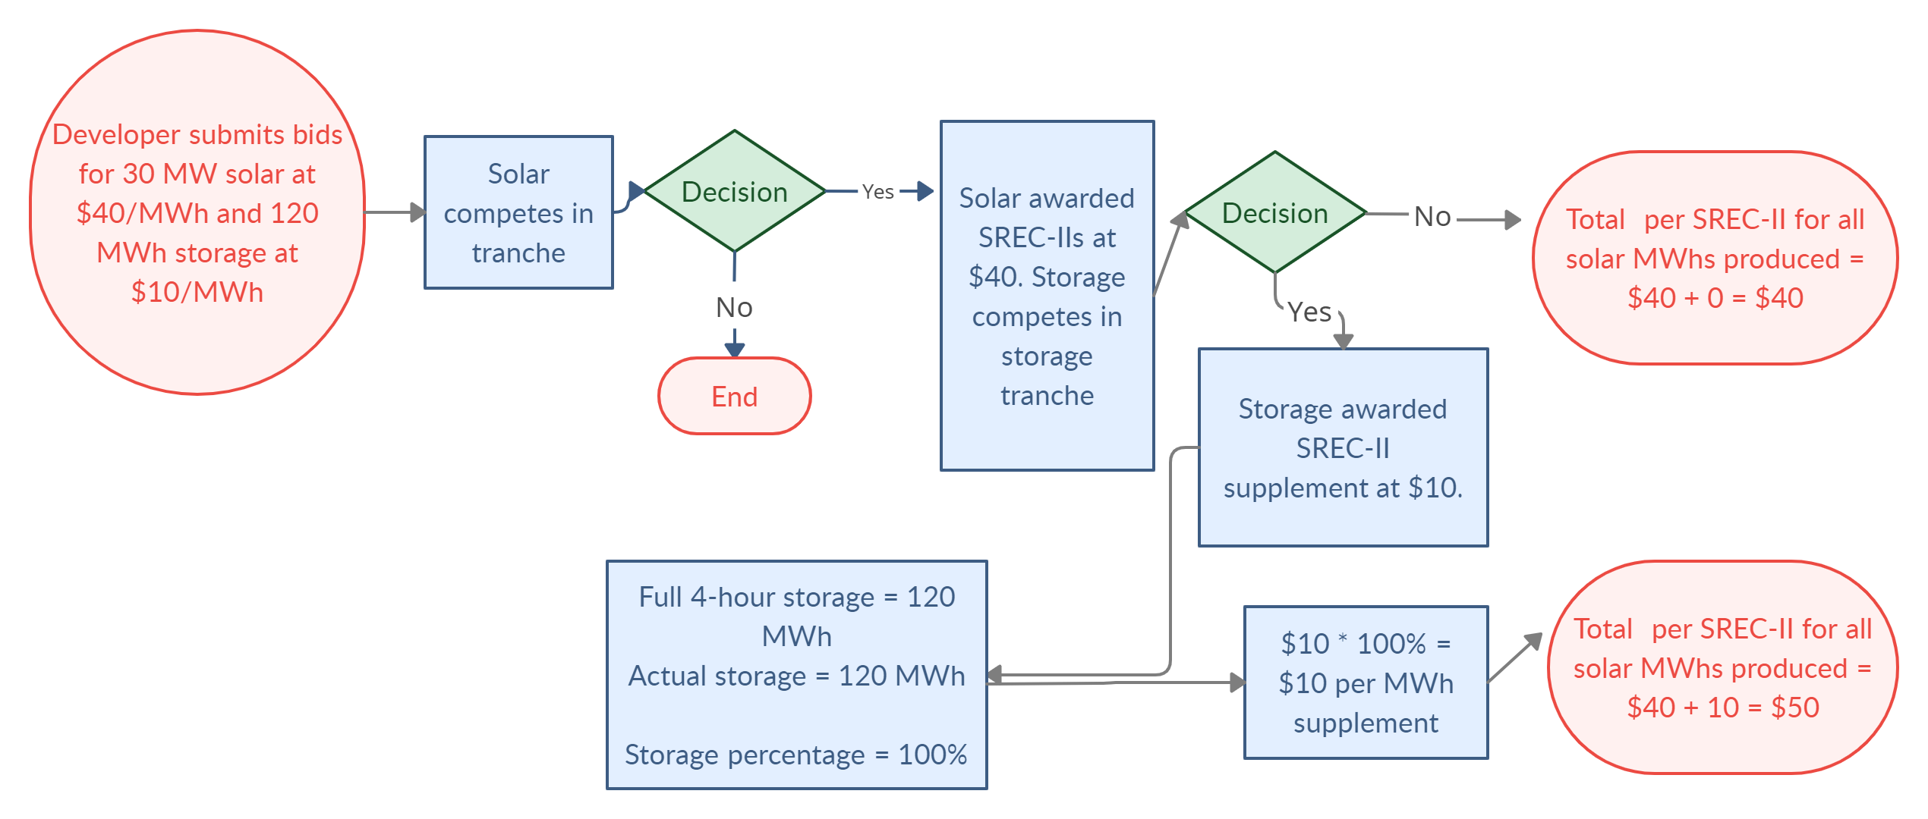
Example of solar with 100% 4-hour storage
Note: The $ values are illustrative only.

Slide 26
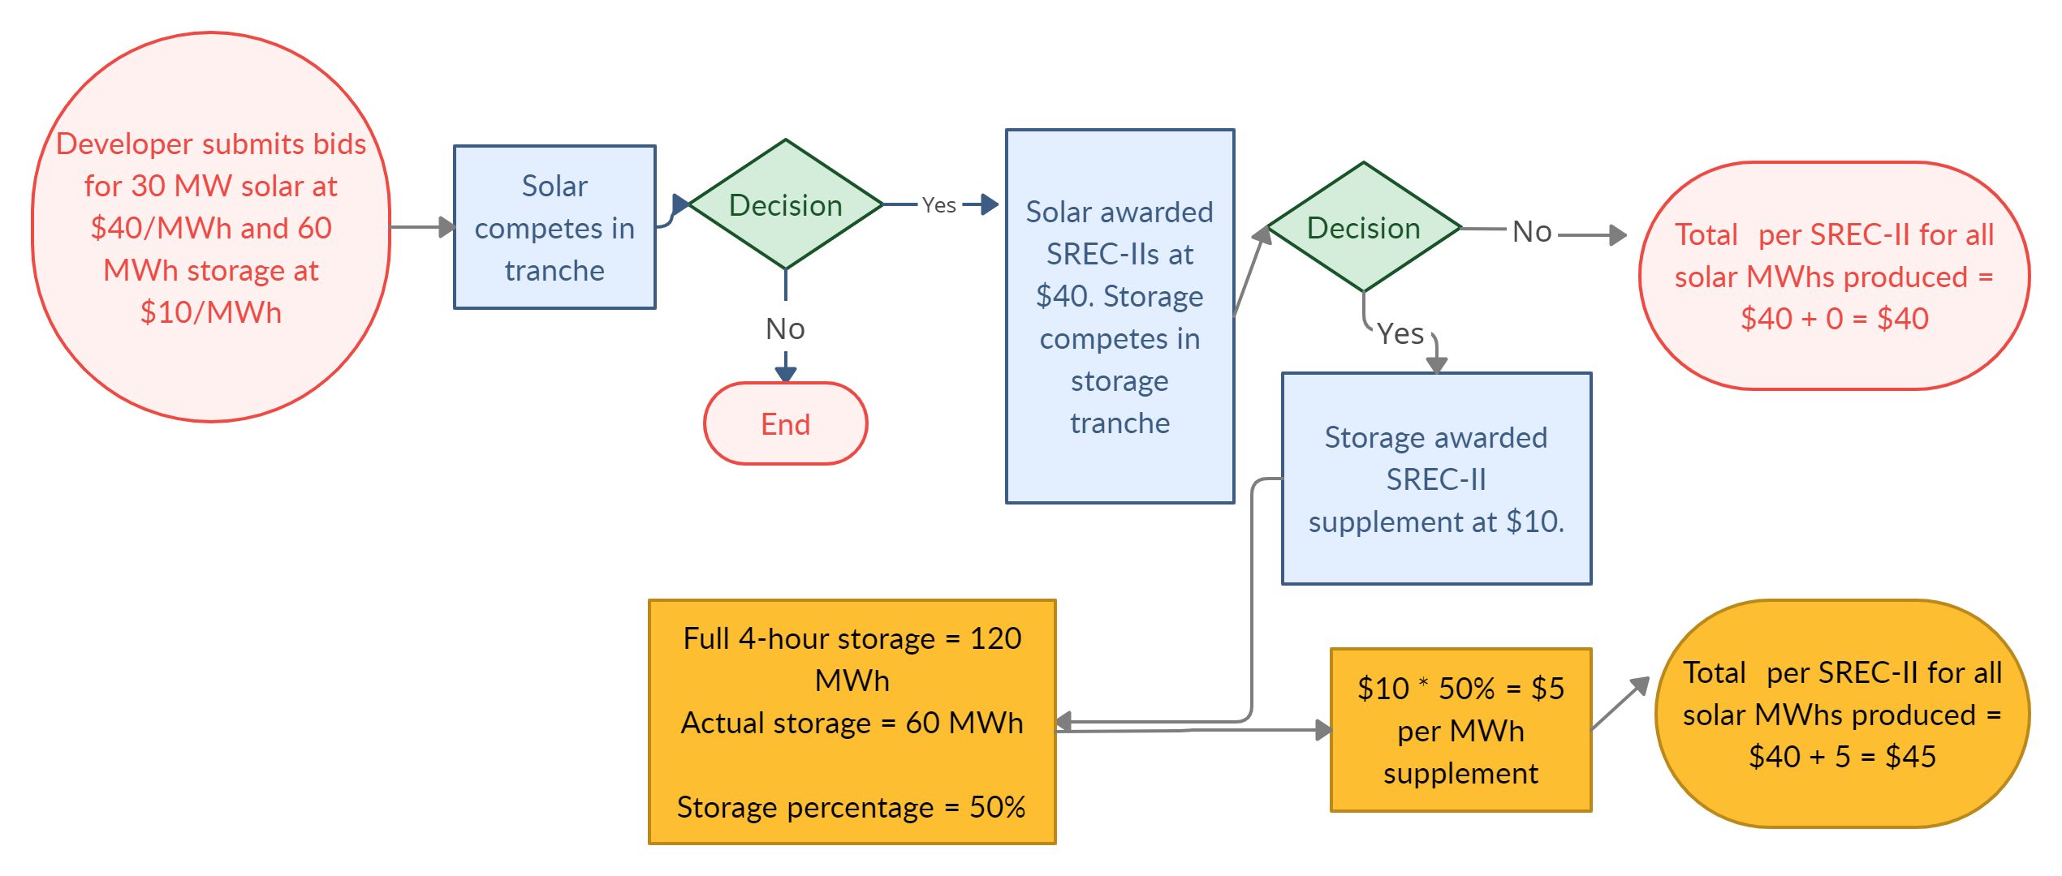
Example of solar with 50% 4-hour storage
Note: The $ values are illustrative only.

Slide 27
Topic 3: Auction Procedure

Slide 28
Proposed Procurement Targets
Tranche Number | Tranche | Initial Procurement Target
1 | Basic Grid Supply | 140 MW
2 | Grid Supply on the Built Environment | 80 MW
3 | Grid Supply on Contaminated Sites and Landfills | 40 MW
4 | Net Metered Non-residential Projects above 5 MW | 40 MW
 | Total | 300 MW
5 | Storage | 160 MWh

Slide 29
Bid Review Process Key Choice
Order of evaluation
Most restrictive first
Lower costs, but potentially less total procurement from special categories
Least restrictive first
(Recommended)
Potentially more from special categories, but at potentially higher cost
Note – Order of evaluation will only matter in terms of deciding awards should there be overlapping prices between tranches. When tranches are distinctly separate in pricing, the order of evaluation can be done in either method and results will not change.

Slide 30
Tranche Review Order
Recommendation:
Step 1: Pre-qualified projects in tranches 1-3 compete on price per MWh
projects receiving awards are removed from pool
Step 2: Remaining projects in Tranches 2 and 3 compete independently, with projects selected by price up to procurement targets (see Slide 28)
Step 3: Storage competition on price per MWh of solar energy production
Step 4: Net metered projects competition

Slide 31
Topic 4: Procurement Frequency

Slide 32
Procurement Frequency
Solar Act of 2021 requires solicitations occur at least once every 18 months. Our target is once every 12 months.
Strong desire for multiple entry points for developers
Counter-balanced by desire for reduced administration costs and robust competition within each procurement/tranche
PJM Queue reform may lead to project delays. As a result, less project availability might result in the need to push procurements to every 18 months
Recommendation: Procurements to be held annually, subject to review and revision on a rolling basis for PJM interconnection issues

Slide 33
Stakeholder Feedback

Slide 34
How to provide stakeholder input
Stakeholder Meeting #2
Today (May 26, 2022)
Stakeholder Meeting #3
June 1 , 2022, 1pm
Final Comments Due
June 20, 2022 (5 P.M.)
Stakeholder Meeting #4
June 6, 2022, 1pm
Topics: Project pre-qualification, bid participation fees, and commercial operation date requirements
Topics: Auction price result, SREC-II payment structure

Slide 35
Stakeholder Comments
Speaking time per person is limited to 5 minutes—please be respectful of other speakers.
The next five speakers are posted in the chat. We will call on speakers in order. If your name is not showing (only a phone number), please raise your hand when it is your turn to speak.
Phone controls for participants
The following commands can be entered via DTMF tones using your phone's dial pad while in a Zoom meeting:
*6 - Toggle mute/unmute
*9 - Raise hand
At the conclusion of our pre-registered speakers list, we will invite additional speakers to raise their hands to speak.

Slide 36
Stakeholder Feedback

Slide 37
Thank you Let’s continue the conversation
Carrie Gilbert
(207) 347-3145 | cgilbert@daymarkea.com
Louisa Lund
(617) 778-2590 | llund@daymarkea.com
DAYMARK ENERGY ADVISORS
Our team brings deep knowledge and an integrated view of energy infrastructure, regulation, and markets to help our clients make well-informed business, capital investment, and policy decisions in the face of transformative change to achieve decarbonization.
DaymarkEA.com

Slide 38
Written Stakeholder Comment Guidelines
The deadline for comments on the Siting Straw is 5:00 p.m. ET on Monday, June 20, 2022
Please submit comments directly to Docket No. QO21101186, using the “Post Comments” button on the Board’s Public Document Search tool.
Comments are considered “public documents” for purposes of the State’s Open Public Records Act and any confidential information should be submitted in accordance with the procedures set forth in N.J.A.C. 14:1-12.3.
Written comments may also be submitted to:
Carmen D. Diaz
Acting Secretary of the Board
44 South Clinton Avenue, 1st Floor
Post Office Box 350
Trenton, NJ 08625-0350
Phone: 609-292-1599
Email: board.secretary@bpu.nj.gov

Slide 39
THANK YOU – Let’s continue the conversation veronique.oomen@bpu.nj.gov

