Slide 1
Economic Fundamentals Analysis of New Jersey Solar Renewable Energy Certificate Market Scenarios
Presentation to the New Jersey Clean Energy Program Renewable Energy Stakeholder Group
11/9/2017
Presented by:
Imran Lalani
Chris MacCracken
Craig Schultz

Slide 2
Purpose and Background
ICF developed an economic fundamentals-based (supply/demand) model to assist in evaluating the effects on the New Jersey solar market from changes in various combinations of policy and regulatory “levers”:
Renewable Portfolio Standard (RPS) Carve-out for Solar
Solar Alternative Compliance Payment (SACP)
Solar Renewable Energy Certificate (SREC) Banking Period
Project Qualification Life
Grid Supply Subsection R (SSR) Injections
The model provides a consistent framework through which to examine the direction and magnitude of impacts from possible changes in these levers on (i) solar capacity builds (MW_{DC}) in New Jersey, and (ii) SREC pricing ($/MWh) in the State over a 5-year horizon.
Intended not as a forecast, but as a useful backdrop to spur discussion on the relationship between policy and regulatory inputs and solar market outputs.
The following slides summarize methods, overall findings, scenarios analyzed within the model, and scenario results.

Slide 3
Interpreting Economic Modeling Results
The model is populated using several key assumptions. The most important assumption is that the demand for SRECs in each year must be balanced with the available potential supply of SRECs, after accounting for SREC banking behavior.
If the supply of SRECs exceeds the demand for SRECs (after SREC banking activity), then:
No economic solar builds are assumed to occur; and
SREC prices fall to Class I REC price levels
In other words, the model does not generate out of market builds, or projects that would be undertaken regardless of prevailing SREC prices and market signals
The model represents a logical framework through which to gauge the magnitude and direction of market responses to policy action. It is not meant to provide point estimates nor forecasted outcomes.

Slide 4
Analytic Methods, Definitions, and Assumptions

Slide 5
Methodology: Building Blocks of the SREC Supply and Demand Framework
The ICF model calculates solar economics at the individual project level across three solar customer categories – utility-scale (grid supply), residential (behind-the-meter), and commercial/non-residential (behind-the-meter).
This model calculates an effective SREC price given the other associated costs and revenues for each of the solar customer categories that allows solar developers/owners to meet their required rates of return.
The model combines data on existing solar generation in New Jersey and solar pipeline capacity data as of 9/30/17 to establish the additional resources needed to meet the RPS solar carve-out demand in each Energy Year (EY).
The eligibility to sell SRECs from the existing stock of solar generators and the SRECs generated by any new solar capacity are tracked within the model, taking into account SREC qualification life.
Banking behavior is captured at a high level – specifying the effective size of the bank maintained over time (as a proxy for current market trading strategies), which in turn affects the level of additional capacity necessary to meet the RPS solar carve-out obligation each year.

Slide 6
Methodology: Notes on Starting Condition of Modeling
Current New Jersey SREC prices are higher than what the current supply/demand balance and the rates of return required for incremental solar capacity would suggest.
The ability to bank SRECs up to five years, and the expectation by some market participants of a further strengthening of RPS solar carve-out requirements over time, suggest that trading behavior may be playing a role in elevating near-term SREC prices. In particular:
The expectation of higher future RPS demand places upward pressure on pricing over time, ultimately approaching the solar alternative compliance payment (SACP) in the years when the market expects most players to be short.
The ability to sell SRECs forward allows market participants to anticipate this event, which in turn pushes up near-term pricing.
Under the Current Policy Case (Scenario 8), there is no change in RPS levels relative current law.
The ICF model solves for solar capacity (“builds”) across the three customer categories (residential, commercial, and grid supply) based on relative cost, RPS demand, and the level of bank maintained by players over the period. Grid supply projects already announced are assumed to come online regardless of SREC pricing levels. Once SREC demand is fully satisfied, no further builds are assumed to take place.
If the New Jersey market moves to over-compliance, SREC prices are assumed to converge to Class I REC levels ($20/MWh).

Slide 7
Definitions
On the NJ SREC Price Trajectories graphs for the 8 Policy Scenarios (slides 20-27), there are three SREC prices that bear definition:
Pure fundamentals price
This reflects the SREC price needed by the marginal solar project built in a year to satisfy the SREC demand. This is also referred to as the equilibrium price (when SREC supply and demand are in equilibrium).
Market clearing price
This price reflects the transition (or trendline) between earlier SREC prices and the pure fundamentals price at the end of the SREC banking period. This price curve is meant to represent the price that market participants would face in each Energy Year.
Current futures price
This is the aggregate futures price curve based on discussions with NJ SREC market participants in late 2016 and early 2017. This reflects the then-current market view on SREC pricing over time.

Slide 8
Assumptions: Federal Solar Investment Tax Credit (ITC)
The modeling assumes that all solar projects access the federal ITC.
This is consistent with the very high level of third-party (non-host) private ownership of solar projects in New Jersey through power purchase agreements (PPAs) and other mechanisms and the observation that many of the host-owned systems will also access the ITC.
The ITC is applied to the following portions of the installed cost:
30% for 2017-2019; 26% in 2020; 22% in 2021
10% in 2022 and thereafter
For details, please see: https://energy.gov/savings/business-energy-investment-tax-credit-itc.
The modeling does not account for the possibility that declines in the ITC will cause some acceleration in deployment (e.g., a rush to build projects at the end of 2019, 2020, or 2021). Such deployment factors are not significant in this fundamentals-driven analysis because the market is near an over-build situation (vs. RPS) already, but solar deployment timing issues may become important in other types of analysis.

Slide 9
Additional Assumptions: Slide 1 of 3
Name | Value | Source
Installed Cost/kW DC in EY2017 | $3.30 for residential; $3.00 for commercial; $1.85 for grid supply | NJ-specific median price data for residential and commercial (≤ 500 kW) systems from Lawrence Berkeley National Laboratory (LBNL), Tracking the Sun 10. Data for grid supply systems in the Northeast in 2015, with adjustments using national year-over-year price declines to obtain 2016 prices and further adjustment from AC to DC capital costs using inverter loading ratio, from LBNL, Utility-Scale Solar 2016. https://emp.lbl.gov/sites/default/files/tracking_the_sun_10_report.pdf https://emp.lbl.gov/sites/default/files/utility-scale_solar_2016_report.pdf
Installed Cost Annual Rate of Decline | 2% (real dollars) | U.S. Department of Energy (DOE), Annual Energy Outlook (AEO), 2017 Assumptions. https://www.eia.gov/outlooks/aeo/assumptions/
Federal Accelerated Depreciation | Applies to project installed cost minus half of the ITC, using 200% declining balance with half-year convention depreciation schedule | Internal Revenue Service.
Property & Sales Taxation on Solar Project | 100% Exemption | New Jersey Division of Taxation.
Annual O&M Costs in EY2017 ($/kW DC) | $33 for residential; $24 for commercial; $14 for grid supply | For grid supply systems, data are from LBNL, Utility-Scale Solar 2016, with conversion from AC to DC costs using inverter loading ratio in that report. Residential and commercial O&M costs from Economic Drivers of PV report for ISO-New England.
Inverter Replacement Cost | 8% of original full project installed cost with replacement in year 15 of project operation | Economic Drivers of PV report by ICF for ISO-New England (February 27, 2015). https://www.iso-ne.com/committees/planning/distributed-generation
Capacity Factor (DC) in EY2017 | 14.4% for residential; 14.5% for commercial systems; 16.0% for grid supply systems | National Renewable Energy Laboratory (NREL) PV Watts-calculated capacity factor for a 7 kW residential roof-mount system and a 100 kW commercial open-rack system in Newark, NJ. For grid supply, used average of open-rack and single-axis tracking outputs from PV Watts for a 2,000 kW system in Newark, NJ. http://pvwatts.nrel.gov/

Slide 10
Additional Assumptions: Slide 2 of 3
Name | Value | Source
Annual Improvement in Capacity Factor (for new systems) | 2% (1/50th) improvement between 2017 and 2019. Additional 2% improvement between 2019 and 2022. | Similar to the annual rate of improvement in system performance in Economic Drivers of PV report for ISO-New England.
Annual Solar Performance Degradation (for existing systems) | 0.5% | NREL, Photovoltaic Degradation Rates - An Analytical Review. https://www.nrel.gov/docs/fy12osti/51664.pdf
Retail Electricity Price Adjustment for Solar Output of Commercial Projects Not Fully Offsetting Peak Demand Charges in EY2017, $/kWh | Minus $0.015 | Reflects a peak demand charge of about $7/kW-month for a commercial building, which is equivalent on a per-kWh basis to about $.0175/kWh and an assumption that PV does offset 15% of peak demand (i.e., about $.0025/kWh).
Net Metering Compensation (as a % of Full Retail Price for Residential & Commercial Projects) | 100% | Simplifying assumption based on approximate current practice.
Federal Income Tax Rate | 35% | Internal Revenue Service.
State Income Tax Rate | 9% | New Jersey Division of Taxation.
Discount Rate | 6% | Informed by solar industry experience. SolarCity used a 6% discount rate in its investor communications.
Annual Inflation Rate | 2.1% | ICF, based on Bureau of Economic Analysis Implicit Price Deflators for Gross Domestic Product.

Slide 11
Additional Assumptions: Slide 3 of 3
Name | Value | Source
Solar Project Duration (years) | 25 | Common project length for solar PPAs and for the warranty of certain solar panels.
Power Prices | Wholesale and retail power prices from DOE's AEO 2017 Base Case projections for NEMS region RFCE.
Class I REC Price ($/MWh)* | 20 | Applied after SREC qualification life ends. See table below for additional detail.
Installed Commercial, Residential, and Grid Supply Solar Capacity and Pipeline of Proposed Solar Projects | New Jersey Clean Energy Program Solar Activity Reports as of 9/30/17. http://www.njcleanenergy.com/renewable-energy/project-activity-reports/project-activity-reports
Total Capacity of Each Customer Category Available to Build in each Energy Year | Historical mix of annual residential, commercial and grid supply builds, NJ Clean Energy Solar Activity Reports: http://www.njcleanenergy.com/renewable-energy/project-activity-reports/project-activity-reports
* Assumed Class I New Jersey REC price of $20/MWh reflects current market trends based on historical data:
Historical Data | EY11 | EY12 | EY13 | EY14 | EY15 | EY16
Class I REC Price | $2.38 | $4.14 | $6.91 | $6.83 | $12.57 | $15.18
Source: New Jersey Clean Energy Program RPS Report Summary 2005-2016
http://www.njcleanenergy.com/files/file/Renewable_Programs/RPS/RPS%20Comp%20EY%202016%20Combined%20Data%20All.pdf
SREC Sales Treatment
 | Residential | Commercial | Grid Supply
Percentage of projects that do not sell SRECs to the market | 20% | 5% | 0%
Percentage of projects that receive a discount on SREC sales (i.e., sell their SRECs to an aggregator that takes a fee) | 80% | 5% | 0%
Size of the discount to the face value of an SREC | 20% | 5% | 0%

Slide 12
Summary of Scenarios and Results

Slide 13
Solar Policy Scenario Definitions
No. | Scenario | SACP | Qual. Life | Banking Period | Increase Solar RPS Carve-Out | Subsection R Injection
1 | Updated SB2276 | Current | 15 yrs | 5 yrs | Higher EY19+ | N/A
2 | Original SB2276 | Current | 15 yrs | 5 yrs | Higher EY18+ | N/A
3 | Original SB2276 with Rate Counsel’s SACP | $50 lower EY18+ | 15 yrs | 5 yrs | Higher EY18+ | N/A
4 | Industry Plan B | $20 lower EY18+ | 15 yrs | 5 yrs | Higher EY18+ | N/A
5 | Staff Alternative A | $50 lower EY21+ | 15 yrs | 5y til EY20, 3 yrs EY21+ | Higher EY21+ | N/A
6 | Staff Alternative B | $50 lower EY21+ | 10 yrs | 5y til EY20, 3 yrs EY21+ | Higher EY21+ | N/A
7 | Grid Supply (Subsection R) Injections | Current | 15 yrs | 5 yrs | N/A | EY19
8 | No Policy Change | Current | 15 yrs | 5 yrs | N/A | N/A
Detailed SREC Requirements (changes from Current Policy highlighted)
Energy Year (EY) | 1: Updated SB2276 | 2: Original SB2276 | 3: Original SB2276 with Rate Counsel SACP | 4: Industry Plan B | 5: Staff Alternative A | 6: Staff Alternative B (10 year QL) | 7: No Policy Change with Subsection R Injection | 8: No Policy Change
EY17 | 3.00% | 3.00% | 3.00% | 3.00% | 3.00% | 3.00% | 3.00% | 3.00%
EY18 | 3.20% | 3.28% | 3.28% | 3.47% | 3.20% | 3.20% | 3.20% | 3.20%
EY19 | 4.64% | 3.55% | 3.55% | 4.15% | 3.29% | 3.29% | 3.29% | 3.29%
EY20 | 5.30% | 3.83% | 3.83% | 4.50% | 3.38% | 3.38% | 3.38% | 3.38%
EY21 | 5.30% | 4.10% | 4.10% | 4.50% | 4.00% | 4.00% | 3.47% | 3.47%
EY22 | 5.30% | 4.10% | 4.10% | 4.50% | 4.30% | 4.30% | 3.56% | 3.56%
EY23 | 5.30% | 4.10% | 4.10% | 4.50% | 4.60% | 4.60% | 3.65% | 3.65%
EY24 | 5.14% | 4.10% | 4.10% | 4.50% | 4.90% | 4.90% | 3.74% | 3.74%
EY25 | 5.05% | 4.10% | 4.10% | 4.50% | 5.00% | 5.00% | 3.83% | 3.83%
EY26 | 4.85% | 4.10% | 4.10% | 4.50% | 5.05% | 5.05% | 3.92% | 3.92%
EY27 | 4.35% | 4.10% | 4.10% | 4.50% | 5.10% | 5.10% | 4.01% | 4.01%
EY28 | 3.74% | 4.10% | 4.10% | 4.50% | 5.30% | 5.30% | 4.10% | 4.10%

Slide 14
Directional Impacts of Potential Policy Changes
Scenario | Arrows depict magnitude and direction of movement in policy lever relative to current policy |  |  |  | Arrows depict magnitude and direction of movement in PV capacity and price impacts relative to current policy
 | SACP | Solar Carve- Out | Banking Period | Qualification Life | PV Builds (Capacity) | SREC Pricing
Scenario 1: Updated SB2276
Scenario 2: Original SB2276
Scenario 3: Original SB2276 with Rate Counsel’s SACP
Scenario 4: Industry Plan B
Scenario 5: Staff Alternative A
Scenario 6: Staff Alternative B
Scenario 7: Current Policy + Grid Supply (Subsection R) Injection
Scenario 8: Current Policy
Note: This is intended not as a forecast, but as a useful backdrop to spur discussion on the relationship between policy and regulatory inputs and solar market outputs.

Slide 15
Net Impacts of Policy Levers Under Scenarios Examined
Policy Scenario | Lever 1 | Lever 2 | Lever 3 | Lever 4 | Impact on SREC pricing | Impact on Solar Builds
Scenario 1: Updated SB2276 | RPS Higher EY19+ |  |  |  | Higher demand leads to higher prices as higher cost builds selected. | Highest level of RPS demand pushes up total builds.
Scenario 2: Original SB2276 | RPS Higher EY18+ |  |  |  | Higher demand leads to higher prices as less economic builds selected. | Higher RPS demand pushes up total builds.
Scenario 3: Original SB2276 with Rate Counsel’s SACP | RPS Higher EY18+ | SACP $50 Lower EY18+ |  |  | No additional impact relative to Scenario 2. | No additional impact relative to Scenario 2.
Scenario 4: Industry Plan B | RPS Higher EY18+ | SACP $20 Lower EY18+ |  |  | Higher RPS requirement pushes up SREC price trajectory. | High level of RPS demand incents large buildout. Builds taper since EY20 and EY21 RPS percentages are equal.
Scenario 5: Staff Alternative A | RPS Higher EY21+ | SACP $50 Lower EY21+ | 3 yr Banking Period EY21+ |  | SREC prices remain well above Class I levels throughout forecast period. | Smoother buildout of resources as the system builds forward in anticipation of growing RPS demand.
Scenario 6: Staff Alternative B | RPS Higher EY21+ | SACP $50 Lower EY21+ | 3 yr Banking Period EY21+ | Qualifica-tion Life 10 yrs | Shorter qualification life leads to higher SREC prices (fewer years in which to recoup project costs through SREC payments). | Builds mirror Scenario 5, since RPS demand identical.
Scenario 7: Current Policy + Grid Supply (Subsection R [SSR]) Injection | SSR Injection that makes residential uneconomic |  |  |  | Prices move lower in response to grid supply injections. | Injection of 67 MW of SSR capacity in EY18 is enough to drive down SREC pricing to make Behind the Meter PV uneconomic.
Scenario 8: Current Policy |  |  |  |  | Prices decline through EY21-22 | Builds decline through EY21-22

Slide 16
How do the Policy Levers Impact the Market?
Policy Lever | Market Impact
 | SREC Price | Solar Builds | Explanation
Lower SACP | Reduces near-term SREC price | No impact (within SACP ranges analyzed) | Value of banked allowances are reduced. If no change in total level of expected RPS demand, then no impact in solar capacity (builds).
Higher Solar Carve-Out % | Increases SREC prices | Increases solar builds | Higher RPS demand drives higher builds. This can result in more expensive resources needing to be built, leading to higher SREC prices.
Shorter Banking Period | SREC price equilibrium reached sooner | No impact / limits near-term over-builds | Shorter banking life reduces the ability to bank in anticipation of a short market in the future. There is also less flexibility around trading strategies within the market, which pushes the system towards equilibrium sooner. Anticipated SREC demand is unaffected, but ability to bank over-compliance in current period into the future is limited.
Shorter Qualification Life | Increases SREC prices | Potentially increases longer-term solar builds | Shorter qualification life results in solar projects needing to recover their costs over fewer years of SREC payments, which pushes up implied SREC prices. Over time, builds become ineligible to generate SRECs sooner, and must be replaced by new capacity, necessitating higher buildouts.
Grid Supply (SSR) Injections | Decreases SREC prices | Modest reduction in capacity | Injection of grid supply solar projects displaces behind-the-meter projects. SREC prices recover quickly after injection ends.

Slide 17
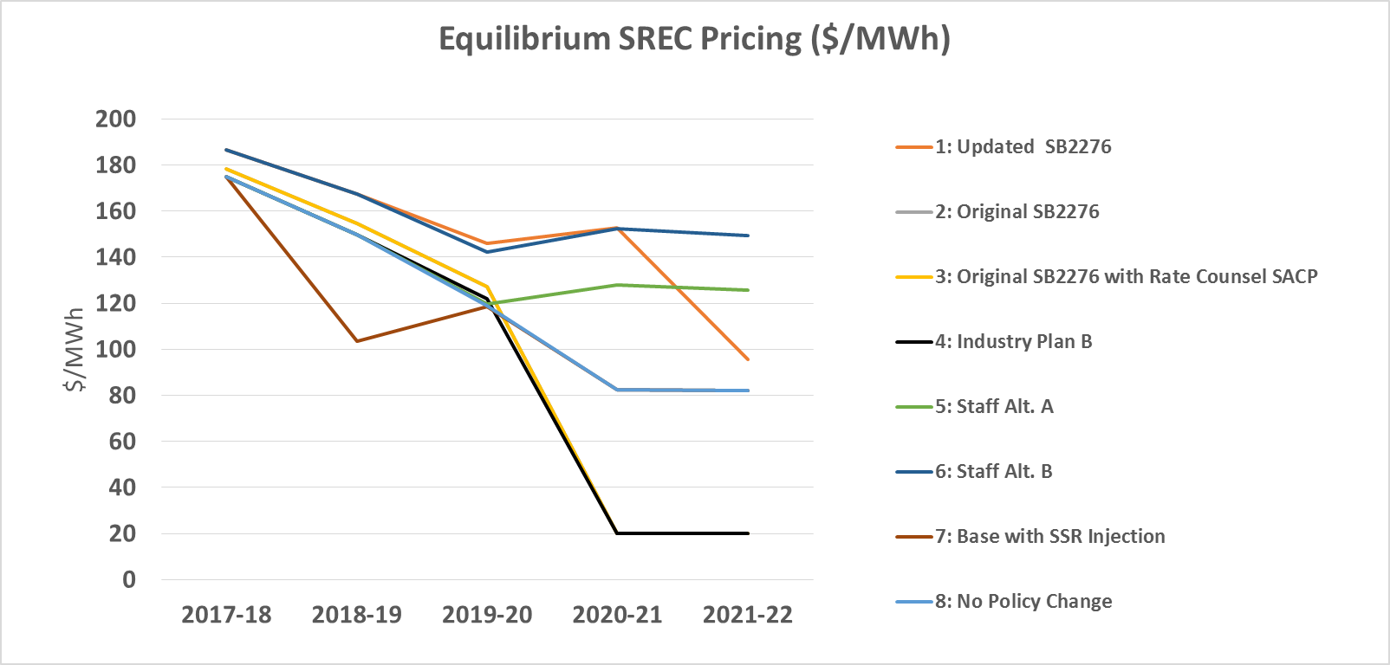
Scenario Results By Year: Estimated New Jersey SREC Prices ($/MWh)
Year | 1: Updated SB2276 | 2: Original SB2276 | 3: Original SB2276 with Rate Counsel SACP | 4: Industry Plan B | 5: Staff Alternative A | 6: Staff Alternative B | 7: Current Policy with SSR Injection | 8: Current Policy
2017-18 | 187 | 178 | 178 | 175 | 175 | 187 | 175 | 175
2018-19 | 168 | 155 | 155 | 150 | 150 | 168 | 104 | 150
2019-20 | 146 | 127 | 127 | 122 | 120 | 142 | 119 | 119
2020-21 | 153 | 20 | 20 | 20 | 128 | 152 | 83 | 83
2021-22 | 96 | 20 | 20 | 20 | 125 | 149 | 82 | 82
Note:
If NJ SREC program is oversupplied, SRECs are assumed to be sold into the wider RPS market, and prices reach Class I REC levels ($20/MWh).

Slide 18
Scenario Results By Year: Estimated New Jersey Solar Builds (MW_{DC})
Projected Behind The Meter Solar Installations:
Year | 1: Updated SB2276 | 2: Original SB2276 | 3: Original SB2276 with Rate Counsel SACP | 4: Industry Plan B | 5: Staff Alternative A | 6: Staff Alternative B | 7: Current Policy with SSR Injection | 8: Current Policy
2017-18 | 300 | 282 | 282 | 295 | 282 | 282 | 282 | 282
2018-19 | 367 | 217 | 217 | 289 | 84 | 84 | 0 | 84
2019-20 | 386 | 95 | 95 | 140 | 104 | 104 | 39 | 36
2020-21 | 122 | 0 | 0 | 0 | 116 | 116 | 0 | 0
2021-22 | 0 | 0 | 0 | 0 | 135 | 135 | 0 | 0
Projected Grid Supply Installations (Including Subsection R):
Year | 1: Updated SB2276 | 2: Original SB2276 | 3: Original SB2276 with Rate Counsel SACP | 4: Industry Plan B | 5: Staff Alternative A | 6: Staff Alternative B | 7: Current Policy with SSR Injection | 8: Current Policy
2017-18 | 88 | 63 | 63 | 88 | 51 | 51 | 51 | 51
2018-19 | 68 | 25 | 25 | 68 | 37 | 37 | 104 | 37
2019-20 | 83 | 15 | 15 | 83 | 15 | 15 | 15 | 15
2020-21 | 71 | 3 | 3 | 3 | 28 | 28 | 7 | 7
2021-22 | 12 | 0 | 0 | 0 | 68 | 68 | 8 | 8
Changing SREC demand levels (i.e., solar carve-out levels in the RPS) are the main drivers of differential builds under the different scenarios.
The updated SB2276, Staff Alternative A, and Staff Alternative B result in continued signals for incremental capacity additions over the forecast period, while the other scenarios move to over-compliance in EY21.
Under the Current Policy Scenario, the market moves towards over-compliance in EY21 (2020-21).
This, in turn, results in very small incremental need for solar generation to meet SREC demand and maintaining the bank, and so very small incremental economic PV additions occur in EY21+.

Slide 19
Results for Each Defined Policy Scenario

Slide 20
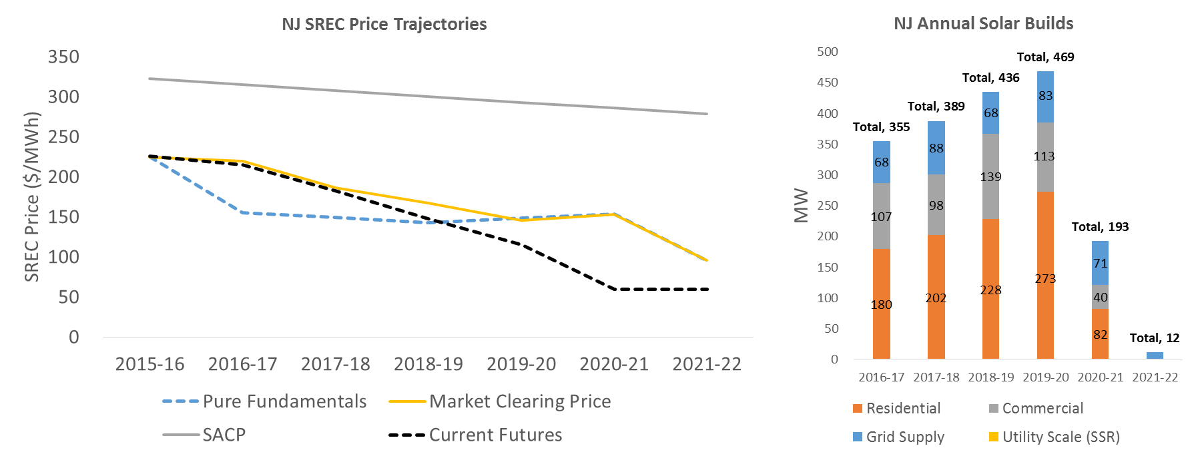
Results for Scenario 1: Updated SB2276
The recently-proposed SB2276 features a significant increase in RPS demand through EY20 and flat/tapering standards thereafter.
This is reflected in the build pattern and price trajectory of this scenario – the elevated levels of SREC demand result in strong continued solar installations through EY21, before dropping sharply in EY22.
EY22 builds only serve to replace degraded capacity and capacity beyond its qualification life.
SREC prices remain strong throughout the forecast period, reflecting the need for incremental solar capacity. The downward SREC price trajectory reflects the changing build mix, increasing power prices, and improving solar cost and performance assumptions.

Slide 21
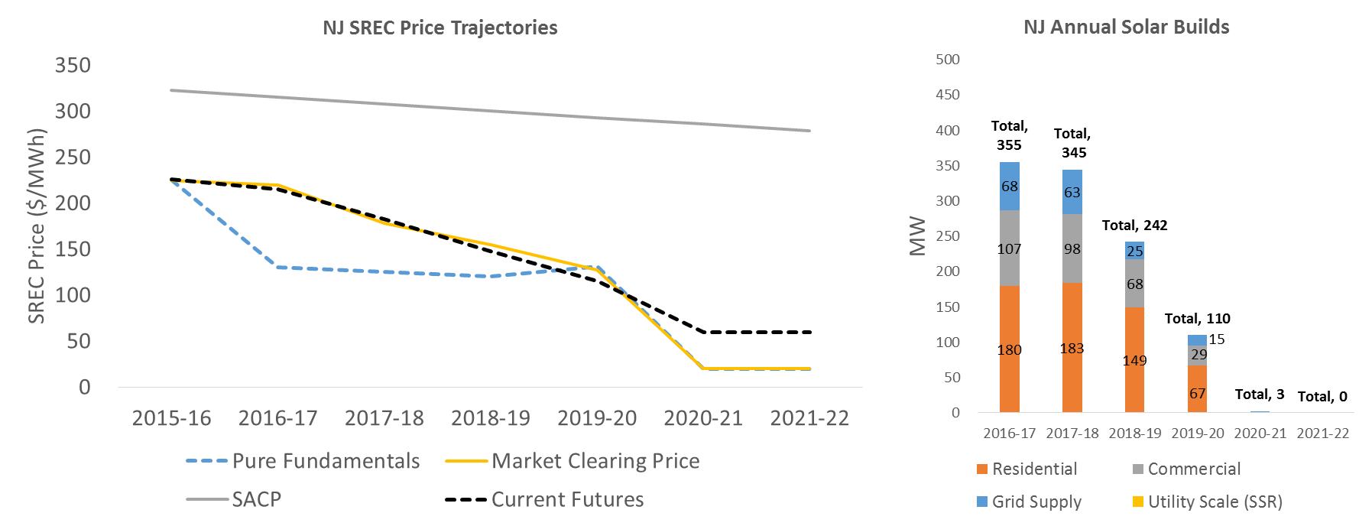
Results for Scenario 2: Original SB2276
The originally-proposed SB2276 features a more modest increase in RPS demand through EY21 and flat standards thereafter.
As compared to current policy, the near term builds are elevated. However, the flat standards in EY21+ mean that there is limited need for incremental solar capacity, and prices converge to Class I REC levels as a result.

Slide 22
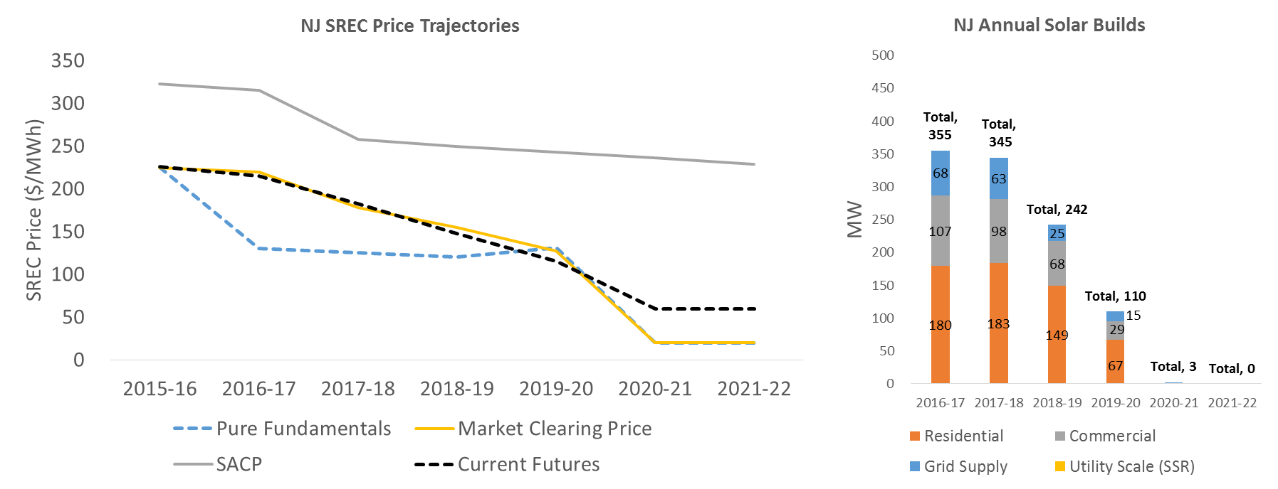
Results for Scenario 3: Original SB2276 with Rate Counsel’s SACP
This scenario features a lower SACP in EY18 onwards, but is otherwise identical to Scenario 2.
Under Scenario 2, there was sufficient incremental solar capacity available at SREC values below the original SACP levels.
Since the updated SACP trajectory used in this scenario is higher than the projected SREC values under Scenario 2, the updated SACP value does not have an impact on SREC pricing.
Since the SREC demand is unchanged between Scenario 2 and Scenario 3, projected capacity additions are also unchanged.

Slide 23
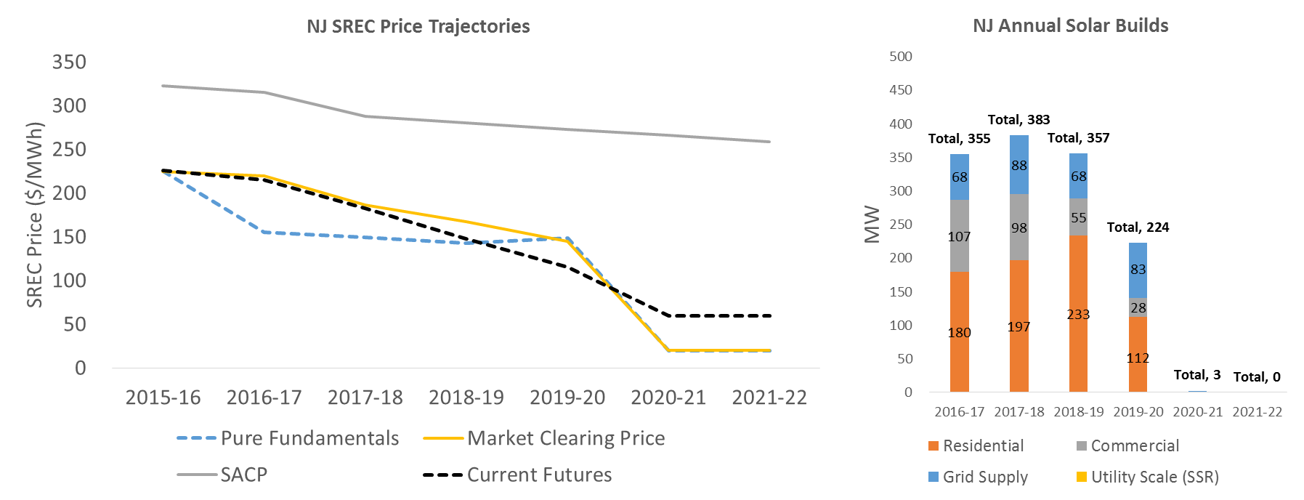
Results for Scenario 4: Industry Plan B
This scenario features an SREC target between the original SB2276 and the updated SB2276.
The solar carve-out in the RPS ramps to 4.5% by EY20 and remains flat thereafter.
This is reflected in the build and pricing pattern – builds remain strong through EY20, as do SREC prices.
Lack of growth in SREC demand in EY21 reduces the need for incremental capacity, and SREC pricing falls to Class I REC levels as a result.

Slide 24
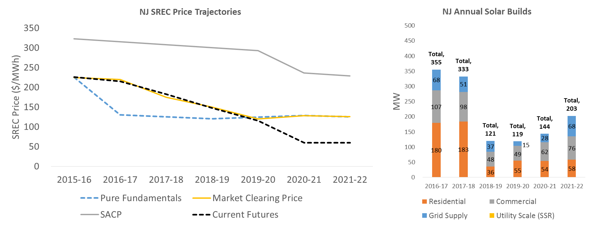
Results for Scenario 5: Staff Alternative A
This scenario features higher RPS levels relative to current policy beginning in EY21 that continue to grow after the forecast period.
As a result of the growing SREC demand over time, the market continues to require incremental solar capacity over the forecast period, which means that SREC pricing remains higher than the current policy scenario.
Solar capacity additions continue to occur smoothly throughout the forecast period.

Slide 25
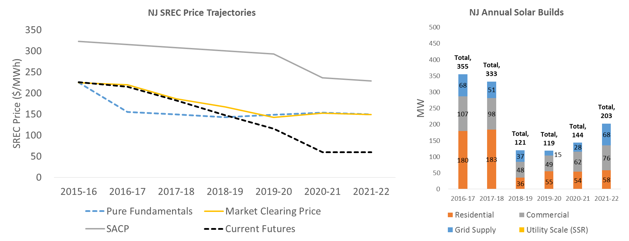
Results for Scenario 6: Staff Alternative B
This scenario is identical to Staff Alternative A, except it features a 10-year Qualification Life as compared to a 15-year Qualification Life under Staff Alternative A.
The Qualification Life is the period for which a particular project is eligible to generate SRECs. A shorter Qualification Life therefore means a shorter period of SREC payments for a given solar project.
The shorter Qualification Life pushes up SREC prices, since projects must recover their costs over a shorter period.
Solar capacity additions are identical to Staff Alternative A since the underlying SREC demand is identical.

Slide 26
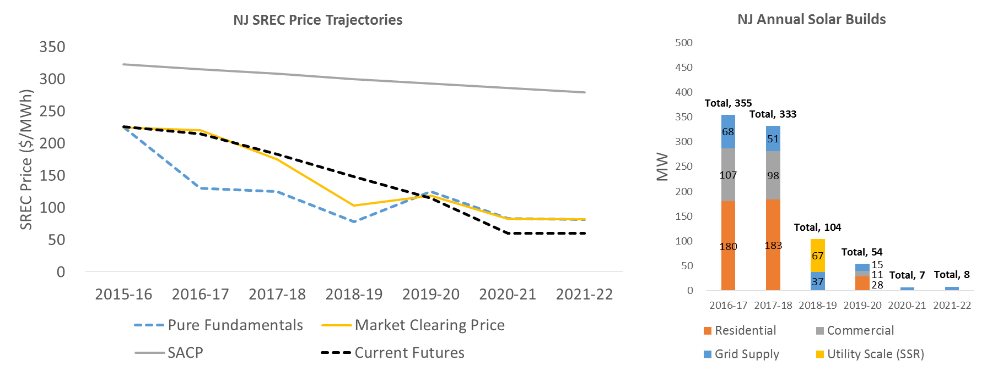
Results for Scenario 7: Current Policy with Grid Supply (Subsection R) Injection
Scenario 7 is identical to current policy (Scenario 8), except for an injection of 67 MW of Subsection R (SSR) capacity, projected to come online in EY19.
The higher performance (capacity factor) and lower cost of grid supply solar relative to behind the meter solar means that the injection of SSR capacity tends to tamp down SREC prices in EY19.
The injection of this level of SSR capacity is also enough to displace completely the economic residential and commercial solar installations that would otherwise have occurred in EY19.
Results in EY20+ nearly match Scenario 8 results, as no further injections of SSR are assumed to occur.

Slide 27
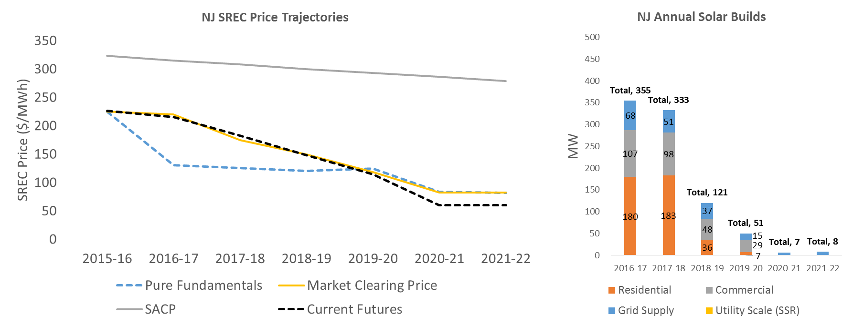
Results for Scenario 8: Current Policy
Market participants anticipate policy action that will increase SREC demand above levels dictated by current policy, which prompts the maintenance of a healthy SREC bank in anticipation of future demand.
If policy change does not occur (i.e., this scenario), the market approaches oversupply and builds and SREC prices decline as a consequence.
The SREC market transitions towards economic fundamentals-based pricing levels by EY20 as participants reconcile to the existing policy design.
The model does not add incremental capacity beyond levels needed to meet demand and banking behavior. Limited incremental builds occur in EY21-22 as a result.

Slide 28
Illustrative Investment Returns by Project Type

Slide 29
Illustrative Investment Rate of Return by Solar Project Type
SREC Price ($/MWh) | Rate of Return (%)*
 | Residential | Commercial | Grid Supply
0 | -15% | -24% | -26%
50 | -9% | -18% | -14%
100 | -3% | -11% | -2%
150 | 3% | -4% | 10%
200 | 9% | 2% | 21%
250 | 15% | 9% | 33%
* Note: The rate of return is for a representative solar build in EY17 that receives the specified SREC payment for every MWh of generation for the first five years of operation (and Class I REC prices thereafter). The five years of SRECs in this calculation reflects a duration that project owners may use to hedge (lock in) SREC prices to secure financing, though the owners can sell their project SRECs into the market for 15 years. The earlier scenarios in this presentation used an SREC qualification life of 15 years unless otherwise noted (for Scenario 6).

