Slide 1
New Jersey Board of Public Utilities
and its Clean Energy Program™
Residential Energy Efficiency Programs

Slide 2
New Jersey Board of Public Utilities
State agency and regulatory authority created to ensure safe, adequate and reliable utility services at reasonable rates for New Jersey customers
Regulates critical services, including natural gas, electricity, water, wastewater, telecommunications and cable television
Has general oversight responsibility for monitoring utility service, responding to consumer complaints and investigating utility accidents
nj.gov/bpu
Notes:
The New Jersey Board of Public Utilities is a regulatory authority with a statutory mandate to ensure safe, adequate, and proper utility services at reasonable rates for customers in New Jersey. Accordingly, the BPU regulates critical services such as natural gas, electricity, water, and telecommunications and cable television.
The Board addresses issues of consumer protection, energy reform, deregulation of energy and telecommunications services, and the restructuring of utility rates to encourage energy conservation and competitive pricing in the industry. The Board also has responsibility for monitoring utility service and responding to consumer complaints.

Slide 3
New Jersey’s Clean Energy Program
Statewide clean energy initiative, administered by the NJBPU
Promotes energy efficiency & renewable sources of energy including solar, geothermal and sustainable biomass
Results in a stronger economy, less pollution, lower costs and reduced demand for electricity
Financial incentives, programs and services for residential, commercial and municipal customers
NJCleanEnergy.com
Notes:
New Jersey's Clean Energy Program promotes increased energy efficiency and the use of clean, renewable sources of energy including solar, geothermal, and sustainable biomass. The results for New Jersey are a stronger economy, less pollution, lower costs and reduced demand for electricity. NJCEP offers financial incentives, programs and services for residential, commercial and municipal customers.

Slide 4

Program Portfolio
Eligible Sector
  Residential
  Home Performance w/ ENERGY STAR® – Retrofit
  HVAC Rebates - WARMAdvantage and COOLAdvantage
  Residential New Construction – New/Gut Rehab
  Appliance Rebates and Recycling
  Discounted Lighting
  Comfort Partners
Programs

Slide 5
Conservation and Efficiency
Renewable Energy
Efficiency
Conservation
Self Generation
Quick payback
Behavior Change
Notes:
Efficiency achieves a relative quick payback but that is contingent on your conservation efforts and the efficiency of the appliances, energy systems, and devices in your home.

Slide 6
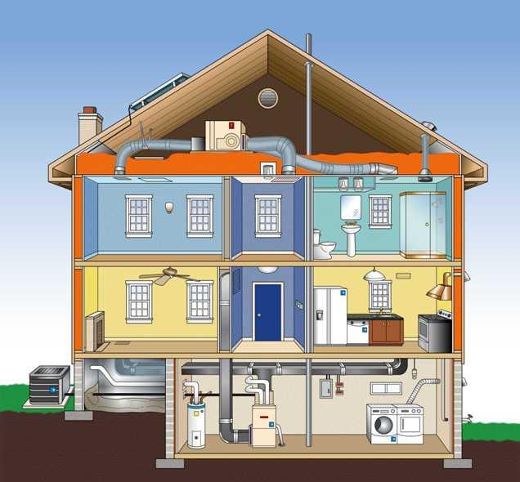
Home Performance with ENERGY STAR®

Slide 7
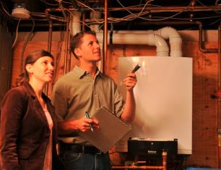
What Is Home Performance?
  Provides home energy assessments and comprehensive energy efficient upgrades
  Specially trained Building Performance Institute (BPI) GoldStar contractors assess homes of any style
  Incentives up to $4,000 *
  0% interest loan up to $10,000 or 4.99% interest loan up to $15,000
*Based on estimated total energy savings

Slide 8
Eligibility
NJ Residential Homeowners
Single Family Homes 1-4 Units & Townhouses, 3 stories or less
Multi-family buildings (≥ 5 Units 3 Stories or less)
(Requires BPI Multi-family Certification & Project Approval)

Slide 9

Steps to Participation
  Select a participating NJ Clean Energy Program BPI GoldStar Contractor
  NJCleanEnergy.com/HP
  Schedule a Home Assessment (fee for assessment may apply as per contractor)
  The contractor helps the homeowner
      Lower energy usage
      Improve comfort
      Ensure health & safety
  Review Recommendations
  Apply homeowner incentives
Notes:
Why selecting a BPI GoldStar contractor is important
2) Home assessment's purpose and achieves…
3) Match Tiers to selected recommendations –depending on the condition of the home, the evaluated recommendations may or may not produce a TES that matches the highest rebate offering requirements
4) Complete process

Slide 10
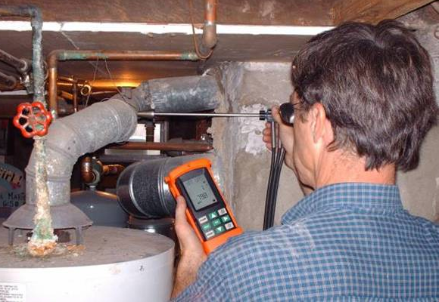
The Home Assessment
  Combustion Appliance Testing
  Diagnostic equipment is used to test the conditions of your heating system, hot water heater and oven
  Testing results determine opportunities for upgrades
  Visual inspection of the house
  Air sealing opportunities
  Insulation opportunities
  Possible health and safety issues (moisture, asbestos, carbon monoxide, indoor air quality) : may resolve asthma, sinus issues
  Optional blower door test
Process

Slide 11

Drivers for Homeowners
Dust and Allergies
Drafts and Comfort
Asthma and Sinusitis
Moisture and Mold
High Utility Bills
Climate Change
Energy Independence
Notes:
There are non-energy benefits for using Home Performance such as safety, health, comfort and durability.

Slide 12
Home Performance Incentives
Incentive Tier | Requirements | Customer Incentive
 | Home Assessment: To be eligible for HPwES incentives, a homeowner must have a home assessment performed by a certified contractor. | None
Tier 2 | Estimated total energy savings (TES) of at least 5% and less than 20%. Must install air sealing and insulation (in at least one location) . HVAC measures are not eligible at this incentive level. May install additional insulation upgrades, duct sealing, duct insulation and water heater measures from the eligible measures list. | $2,000 rebate, not to exceed 50% of the costs of the eligible measures used by your contractor to calculate TES and Up to a $5,000 loan at 0% where a utility loan is unavailable
Tier 3 | Level 1 - Estimated TES of at least 20% and less than 25%. Must install air sealing and insulation (in at least one location) . May include any other eligible measures. | $3,000 rebate, not to exceed 50% of the costs of the measures used to calculate TES and Up to a $10,000 loan at 0% or a $15,000 loan at 4.99% where a utility loan is unavailable
Tier 3 | Level 2 - Estimated TES of at least 25% or greater. Must install air sealing and insulation (in at least one location) . May include any other eligible measures. | $4,000 rebate, not to exceed 50% of cost of the measures used to calculate TES and Up to a $10,000 loan at 0% or a $15,000 loan at 4.99% where a utility loan is unavailable

Slide 13
Home Performance Case Study
Dianne Leoni*, Hillsborough, NJ
Size and Age of Home: 2,684 Square Feet and 30 years
Main Concerns: Age of HVAC equipment and drafts. Also hoped to reduce costs and have home run more efficiently.
Project Cost: $16,000
Rebate: $4,000
Loan: $10,000 at 0%
Measures installed: Gas Water Heater, Furnace, Central AC, Air Sealing, Insulation
*2016 Customer
Notes:
HVAC equipment was original to the house (30 years)

Slide 14
Home Performance Case Study
“We are very pleased with our experience. Everyone involved was informative and helpful. The process took only one day. We were amazed to see the difference and feel the difference. I highly recommend every homeowner consider evaluating the energy efficiency of their home. We are sleeping better at night knowing our new units are the most efficient and reliable. We also feel better knowing we are reducing our carbon footprint.”
- Dianne Leoni
Customer
Testimonial:

Slide 15
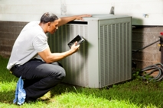
WARM and COOLAdvantage
  Heating and Cooling Systems
Equipment Rebates:
  Ductless Mini-Split Units ($500)
  Air-Source Heat Pumps ($500 or $300)
  Central AC Units ($500 or $300)
  Geothermal Heat Pumps ($500)
  Gas and Oil Furnaces ($250 or $500)
  Gas and Oil Boilers ($300)
  Gas Water Heaters ($300)
  Heat Pump Water Heater ($500)
  Combination Boiler/Furnace and Water Heater ($700 or $950)
  NJCleanEnergy.com/COOL & NJCleanEnergy.com/WARM – see minimum energy efficiency levels as per the eligible measures document
Equipment
Notes:
Some incentives will change August 1, 2016.

Slide 16
Residential New Construction
New Construction or reconstruction (gut rehab)
Demand for power is less
Operates more efficiently
15%-50% more EE and can save $200-$400 yearly

Slide 17

Benefits of an Energy-Efficient Home
Homes are designed and built to standards well above other homes on the market today
Builders work with Rating Companies credentialed through the Residential Energy Services Network (RESNET) to build or reconstruct homes to energy efficient standards
Builders receive incentives for certified ENERGY STAR Homes, Zero Energy Ready Home and Multi-Family High Rise Homes

Slide 18
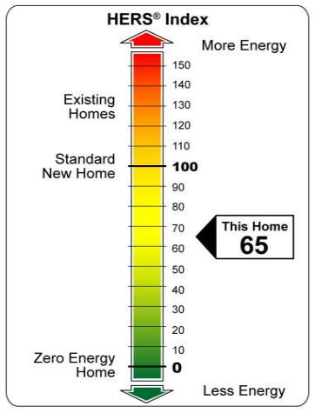
HERS Index
The rating of a home is based on the Home Energy Rating System (HERS) Index
The lower the number, the more energy efficient the home is
Homes undergo a process of inspections, testing and verification to ensure that it meets strict requirements set by the EPA

Slide 19
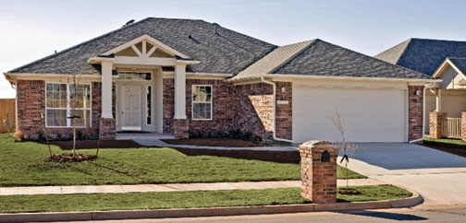
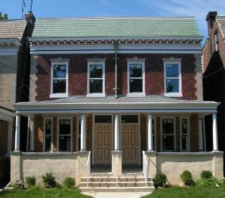
Eligibility
New and gut rehab residential construction, including:
Custom homes
Single-family production homes
Townhouses
Multi-family apartments
Active adult single-family and low/mid-rise housing

Slide 20
Other Characteristics
A complete thermal enclosure system, includes:
  Comprehensive air sealing
  Quality-installed insulation
  High-performance Windows
High Efficiency HVAC Systems
Energy-efficient Lighting and Appliances
For more information: NJCleanEnergy.com/RNC

Slide 21

Appliance Rebates
$50 or $75 rebates on select clothes washers and refrigerators
$100 or $300 rebates for dryers
Ask retailers for more information or visit:
  NJCleanEnergy.com/CLOTHESWASHERS
  NJCleanEnergy.com/DRYERS
  NJCleanEnergy.com/FRIDGEREBATE
Eligible products lists are included on each page
Visit NJCleanEnergy.com/FINDER to see if the
models you are considering qualify

Slide 22

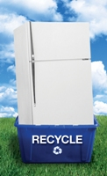
Appliance Recycling
  Recycling for old, inefficient refrigerators and freezers
  FREE pick-up and a $50 rebate
  Approximately 95% of each appliance is recycled
  Schedule appointments online at NJCleanEnergy.com/RECYCLING

Slide 23

Discounted Lighting
  Lighting represents 20% of your home’s electricity bill. ENERGY STAR lighting (LEDs) save $30-$80 over the bulb’s lifetime
  Discounted efficient lighting is available at participating retailers such as Costco, Home Depot, Lowes, Sam’s Club, Walmart, BJ’s, Batteries Plus and Shop Rite.
  Looks for this sign in stores:

Slide 24
Comfort Partners
This free, energy saving and education program is geared to low-income homeowners who have an income at or below 225% of the federal poverty guidelines.
Eligible participants receive free installation by a Building Performance Institute (BPI) GoldStar contractor of the following (on a home specific basis):
  Energy efficient lighting
  Hot water conservation measures (water heater insulation, water heater pipe insulation and energy-saving showerheads and aerators)
  Replacement of inefficient refrigerators and thermostats
  Insulation upgrades (attic, wall, etc.)
  Blower-door guided air sealing, duct sealing and repair
  Heating/cooling equipment maintenance

Slide 25
Comfort Partners
Homeowners also receive comprehensive, personalized energy counseling and education
Contact 800-915-8309 for more information
Notes:
Households that receive USF, Lifeline and/or Pharmaceutical Assistance to the Aged and Disabled (PAAD) are also eligible. The customer must also use the home as a primary residence and be the ratepayer of record with the electric or gas utility. If the customer’s primary source of heat is oil, propane or kerosene, please contact the NJ Department of Community Affairs, Office of Weatherization at 800-510-3102 or locate the county office that serves the home.

Slide 26
Assistance Programs
Help Meet Your Energy Needs:
State and Federal Programs
  Winter Termination Program
  Universal Service Fund (USF) Program
  The Low Income Home Energy Assistance Program
  Lifeline Program
  Comfort Partners Program
  Temporary Relief of Utility Expenses (TRUE)
  New Jersey Statewide Heating Assistance and Referral Energy Service, Inc. (NJSHARES)
Call your utility company for more information.
Notes:
New Jersey also offers various other programs that provide additional assistance to families that may need it. Utility companies have information on the state and federal programs that are offered.

Slide 27
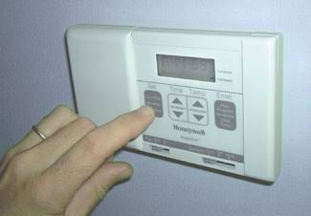
Energy Saving Tips
Regulate heating and cooling systems
Set the temperature 8 degrees lower when you are asleep or away in the winter
Set the temperature 7 degrees higher when you are away and 4 degrees higher when you are asleep in the summer
Turn on the ceiling fan to improve airflow and create gentle breezes
Turn fans and lights off when you’re not in the room
Notes:
There are many Energy Saving Tips that can be implemented to save energy in your home. Purchasing a programmable thermostat saves money on utility costs.

Slide 28

Energy Saving Tips
Let the Heat In or Out
Block out heat in the summer by keeping blinds or curtains closed during the day (especially on south-facing windows)
Let the heat in on winter days by opening them

Slide 29
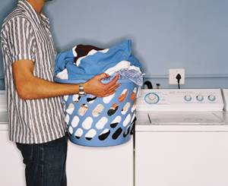
Energy Saving Tips
Use Less Hot Water
Fact: Water heating accounts for around 12% of a family’s utility bill
Lower water heater temperature from 150° to 120°
Wash your clothes in cold water
Take a short shower instead of a bath
Install low-flow showerheads and faucets
Fix leaks

Slide 30
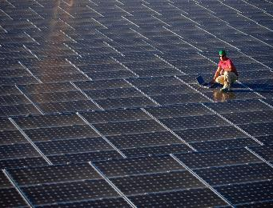
Renewable Energy
SREC Registration Program (SRP)
  Projects MUST be registered in the SRP prior to the start of construction in order to establish the projects eligibility to earn Solar Renewable Energy Certificates (SRECs)
  An SREC represents all the clean energy benefits of electricity generated from a solar energy project
  SRECs can be sold or traded separately from the power, providing owners a source of revenue to help offset the cost of installation
What to consider ….
Is my home as energy efficient as possible?
How do I determine if my home is suitable for Solar?
What State and Federal Incentives are available to help finance the system?
What are the pathways to purchasing a system?
Contact a solar company for more information
Notes:
Solar –only give SREC’s
Tax Credit of 30% until 2019
10% there after until 2022
emphasize the importance of conducting energy efficient upgrades first before installing solar.
State—SREC program –solar registration energy credit—sell back into the marketplace as you would a stock/commodity
Perform your due diligence when researching the feasibility of a PV for your home & ownership opportunities:
-Purchase: like buying a car—owner and benefit from all electricity the system produces
-Lease: solar company owns the system and leases it to you. Solar company responsible for maintenance .
4) Power purchasing agreements (PPA) : pay for the electricity generated for a set-rate that was agreed upon. Solar company install and own the PV.

Slide 31
How do SRECs Work?
Each time a solar installation generates 1,000 kWh of electricity, an SREC is earned
Solar project owners report the energy production to the SREC Tracking System
The reporting allows SRECs to be placed in the customer’s electronic account
SRECs can then be sold on the SREC Tracking System, providing revenue for the first 15 years of the project’s life

Slide 32
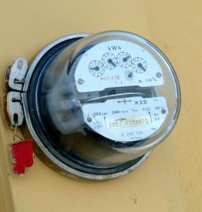
What is Net Metering?
When a renewable energy system produces more electricity than the customer actually uses, the customer will be compensated with credits at the full retail value of the electricity production over and above what they use
Production in excess of a customer’s annual usage is credited at a wholesale rate
Notes:
Your electric meter spins forward when electricity flows from the electric distribution company into the home or business, and backwards when power flows from the home or business to the electric grid. In New Jersey, Electric Distribution Companies and third party electric suppliers are required to credit customers with solar systems or other renewable energy generators for each kilowatt-hour produced on an annual basis. The customer-generator reduces consumption for electricity with their renewable energy system during a monthly billing cycle with any excess generation being credited at retail rates on the following month’s bill. Should excess generation accrue to the end of an annual period, the customer-generator is compensated for any remaining credits at the wholesale power rate by the Electric Distribution Company or their third party electric supplier.

Slide 33
Alternative Funding Options
Power Purchase Agreements (PPAs)
Leasing Arrangements
Why?
They want solar but:
Don’t have the capital
Have the capital but have other priorities
Can’t take advantage of the federal tax benefits
Don’t want to project manage the installation
Don’t want to take SREC market risk

Slide 34
Thank You
Thank You for your time
Visit NJCleanEnergy.com
Call 866-NJSMART
For the latest updates on program announcements or new incentives, subscribe to the NJ Clean Energy Program E-Newsletter at: NJCleanEnergy.com/NEWSLETTER

