Slide 1
  NJCEP Strategic Planning
  Stakeholder Focus Groups
New Jersey Board of Public Utilities
January 26, 2017

Slide 2
Agenda
Introductions
Purpose of today’s focus group
Overview of Strategic Planning process
NJCEP draft Objectives
Discussion

Slide 3
Purpose of today’s focus group
To gather perspectives from interested Clean Energy stakeholders on how the NJCEP can most effectively achieve its objectives

Slide 4
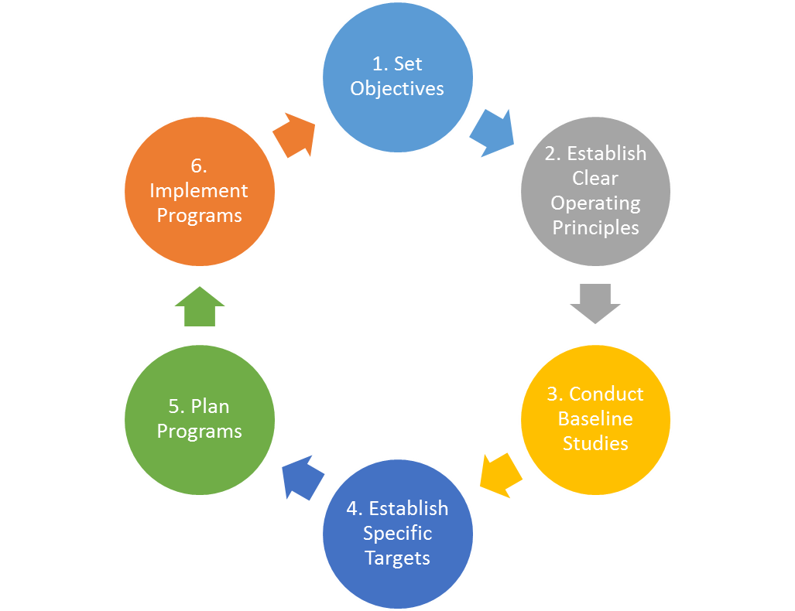
Key Planning Steps
Rigorous planning leads to better outcomes at lower cost
Learning from leading states will help NJ move its planning efforts forward
Stakeholder engagement will assist NJ craft a successful strategic plan

Slide 5
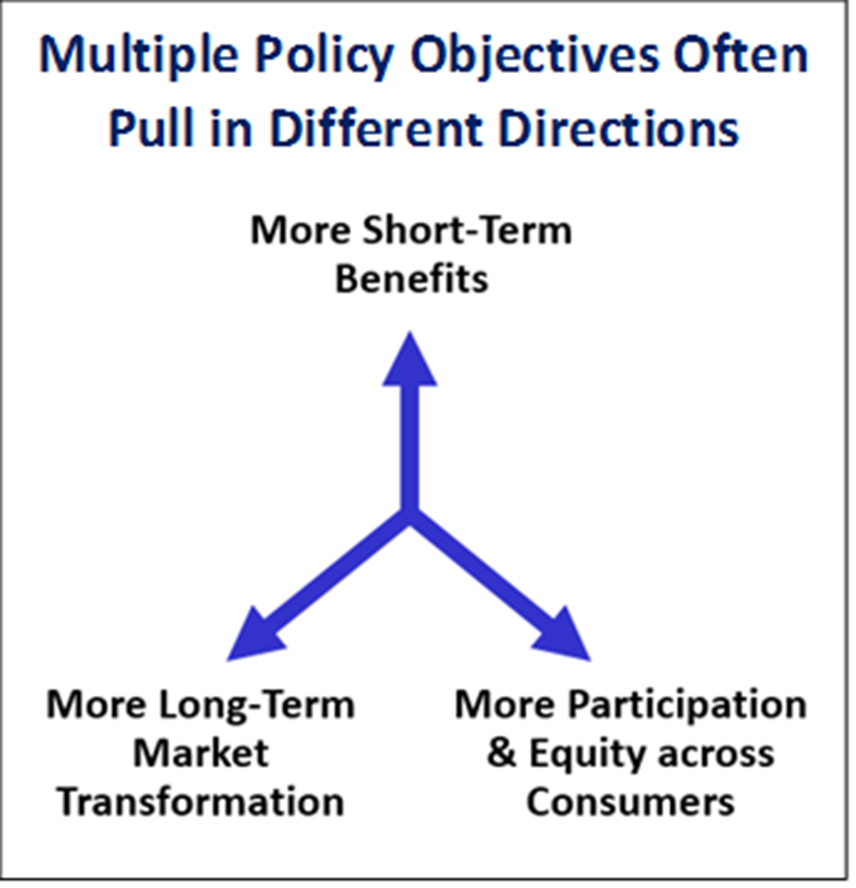

Slide 6
Proposed NJCEP Objectives
Lower Energy Bills: “Reduce the high cost of energy and lower energy bills by maximizing lifetime energy savings per dollar spent (kWh and therms)”
Maximizing peak demand (kW) savings
Providing equitable access to efficiency and renewable energy programs
Promoting the development and transformation of energy efficiency and renewable energy markets
Reducing long-term environmental impacts of energy use
Minimizing lost opportunities

Slide 7
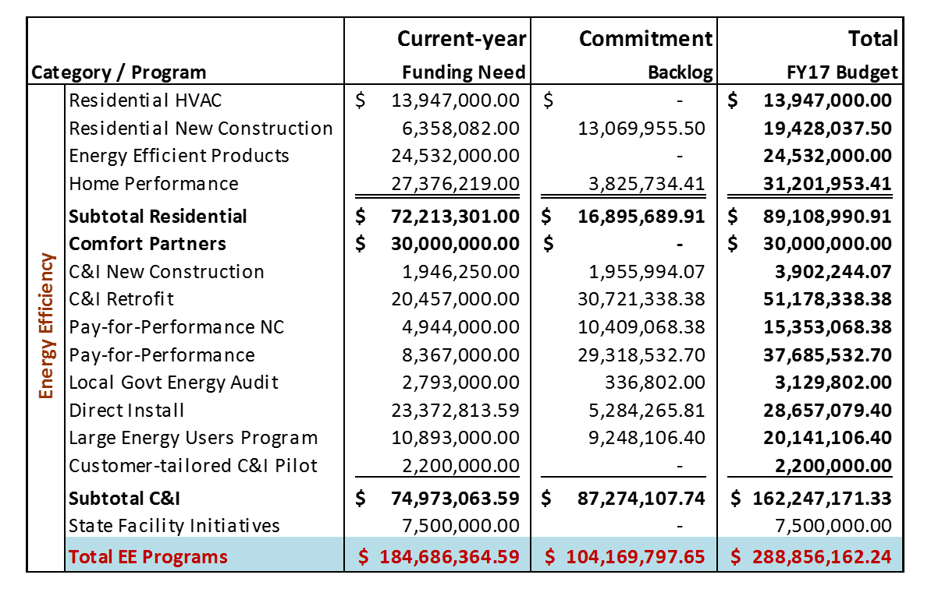
FY17 NJCEP EE Budget

Slide 8
Discussion Questions:
What do you think the most important job of the NJCEP is?

Slide 9
Discussion Questions:
What should the programs be focused on achieving?

Slide 10
Discussion Questions:
In your experience, what aspects of the NJCEP are most important to maintain in the face of any potential changes?

Slide 11
Discussion Questions:
In your experience, what aspects of the NJCEP should be changed to improve the programs’ performance?

Slide 12
Discussion Questions:
Are there potential energy savings that the NJCEP is not currently capturing for the state? What do you think it would take to capture those savings?

Slide 13
Discussion Questions:
Are there emerging opportunities for the NJCEP to capture additional energy savings through new technologies or program approaches?

Slide 14
Opportunities to provide further input:
  Additional focus groups at http://www.njcleanenergy.com/strategicplan
  Email comments to strategicplan@njcleanenergy.com
  Anticipate opportunity to comment on draft program concepts
  Public comment on FY18 Compliance Filing

