Slide 1


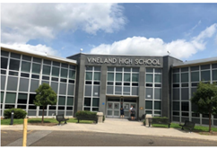
VINELAND BOARD OF EDUCATION
Vineland, NJ
Project Date: February 21, 2025
Project Type: ESCO Model- DCO
Project Overview:
  Generated $1,070,933 in annual energy savings
  34% reduction in CO₂ emissions
  Projected Saving: $30,928,405 total annual savings /20-year term
Financing Profile:
Energy Conservation Measures (ECMs) Installed:
  Project Cost : $19,540,025
  LED Lighting Tube Retrofit
  Project Term/Payback : 20 years
  Type of Financing: Refunding Bond
  Building Envelope Weatherization
  Applied Incentives : $ 32,700
  HVAC Upgrades/Replacements
  Overall Savings $ 30,928,405
  Energy Management System Replacement
Facilities Profile:
Performance Metrics:
  Number of Buildings: 18
  5,964,082 kWh saved.
  Total Square Footage: 1,614,388 sq ft
  3950 tons of greenhouse gas emissions reduced.
  41,932 therms saved.
Public Entity Contact Information :
Energy Service Company Contact Information:
School Business Administrator : Scott Musterel
Project Manager: Greg Burns
smusterel@vineland.org
gregb@dconergy.com
ESIP PROJECT BRIEF

