Slide 1
New Jersey’s
Clean Energy ProgramTM
Clean Energy and Efficiency Opportunities for Residential, Commercial, Industrial, and Institutional Buildings
[Date]
Notes:
TITLE SLIDE OPTION A

Slide 2
NJCEP Background
Administered by
New Jersey Board of Public Utilities’ Division of Clean Energy
Funding
Societal Benefits Charge (SBC) on utility bill
Program Goals
Education
Change behavior
Provide opportunity for ALL NJ residents to
reduce energy and lower operating cost
Protect the environment and lower emissions
Meet Governor’s goal of 100% clean energy by 2050

Slide 3
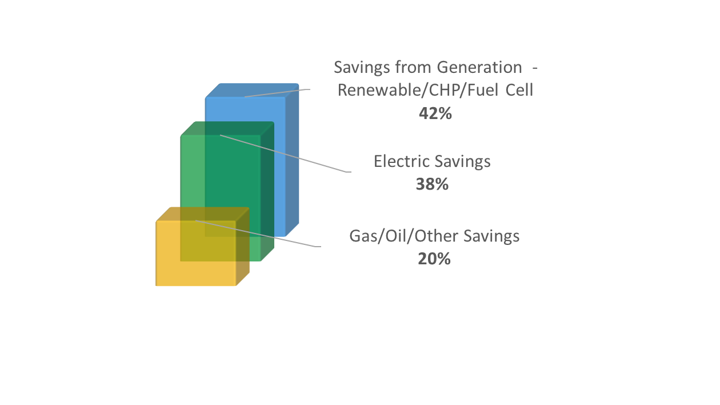
Program Performance…
FY19 data
131,000+ applications processed in FY19
Energy Savings are delivered through electric, gas, oil, other efficiencies and generation
$136,000,000+ incentives paid in FY19

Slide 4
…Brings Real-World Results
FY19 data
Clean Energy Programs eliminated enough CO₂ to equate to:
96,000+ cars removed
7,400,000+ trees planted
452,616 metric tons greenhouse gases eliminated
Notes:
Note
Stats are just FY19 performance of metric tons of CO2 eliminated annually.
Source
https://www.epa.gov/energy/greenhouse-gases-equivalencies-calculator-calculations-and-references

Slide 5
NJCEP Portfolio of Programs
Renewable ENERGY
SPECIALIZED ENERGY EFFICIENCY
COMMERCIAL & INDUSTRIAL
DISTRIBUTED ENERGY RESOURCES
RESIDENTIAL
Offshore Wind
SREC Registration
Community Solar
Community Energy Grants
State Facility Initiatives
R&D Energy Tech Hub*
Workforce Development*
Energy Audits
Energy Efficiency Incentives
Multifamily*
High Performance Building Competition*
Trade Allies
Combined Heat & Power – Fuel Cells
Microgrid Development
Battery Storage*
Electric Vehicles*
New Construction
Existing Homes
Energy Efficient Products
Trade Allies
* coming soon!

Slide 6
C&I Programs

Slide 7
C&I Portfolio of Programs
FIRST ½ FY20
Eligible Sectors: Commercial, Industrial, Government, Schools, Non-Profit, Institutional and Multifamily
Measurement & AUDITS
COMPREHENSIVE PROGRAMS
SINGLE MEASURE REBATES
DISTRIBUTED ENERGY RESOURCES
Energy Benchmarking
Local Government Energy Audits (for non-profits too)
Multifamily*
Single Measure
Multi-measure
Large Energy Users
Pay for Performance
Existing Buildings
New Construction
Direct Install
Customer Tailored Energy Efficiency Pilot
SmartStart
Existing Buildings
New Construction
Combined Heat & Power - Fuel Cells
Microgrid Development
Battery Storage*
Electric Vehicles*
FY20
Some programs offer enhanced incentives to buildings:
in a UEZ or OZ
owned or operated by a local government
owned or operated by a K-12 public school
* coming soon!

Slide 8
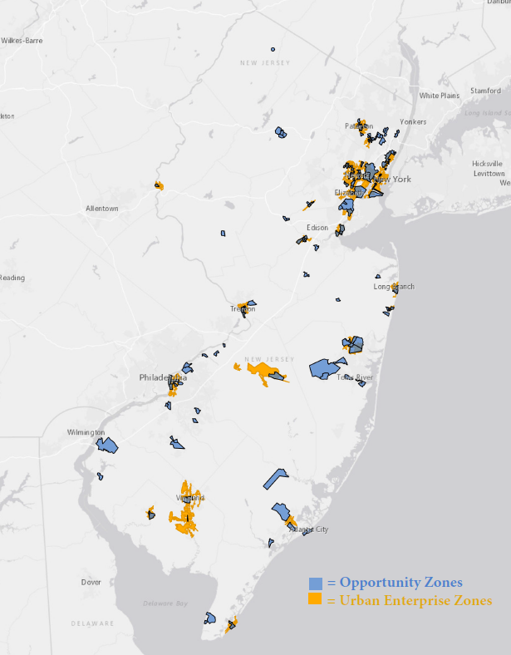
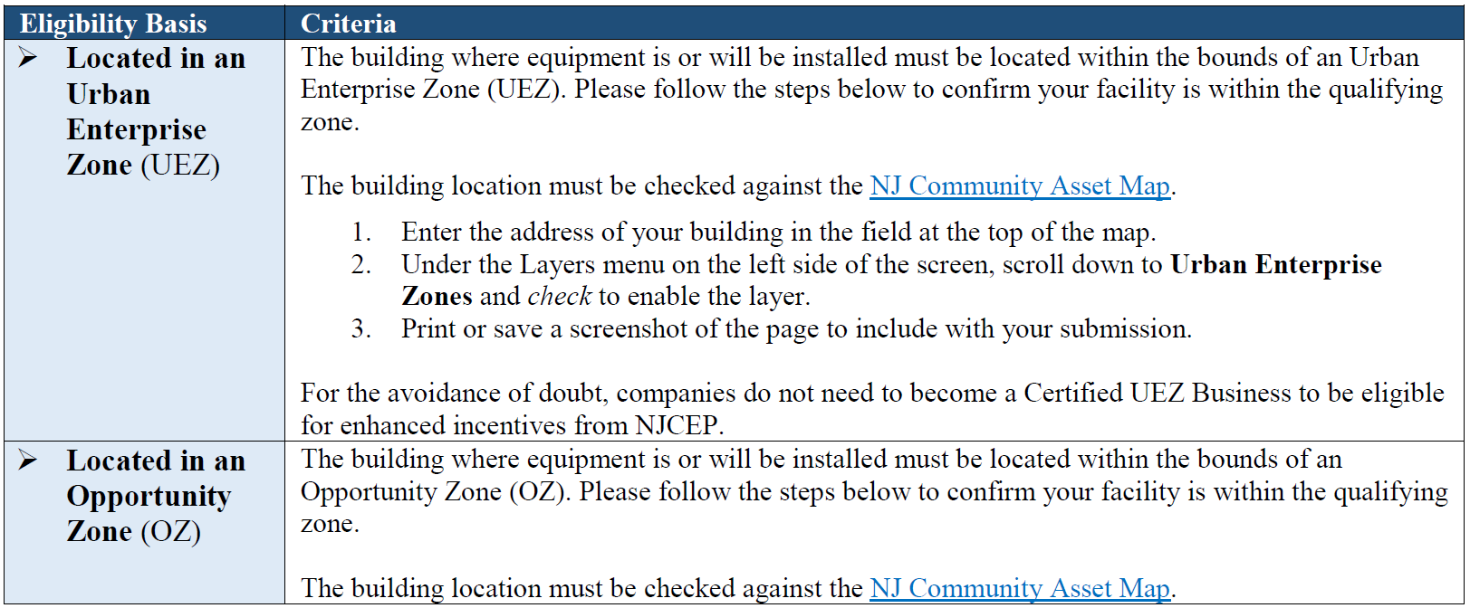
Definitions: UEZs and OZs
FY20
Some programs offer enhanced incentives to buildings:
in a UEZ or OZ
owned or operated by a local government
owned or operated by a K-12 public school
Click here for a link to NJ Community Asset Maps

Slide 9
Benchmarking
Measurement & AUDITS
NJCleanEnergy.com/BENCHMARKING
WHO
Commercial, Industrial, Agricultural, Government, 501(c)(3) Non-Profit, and Institutional Entities
Cost
Free
WhY
Compare your building to other similar buildings nationally
Suggestions for improving operations and maintenance
Personalized incentive program eligibility and account manager follow-up support
ENERGY STAR® Portfolio Manager account setup and score
Great opportunity to be a leader in benchmarking energy and water use, prior to the 2024 deadline.

Slide 10
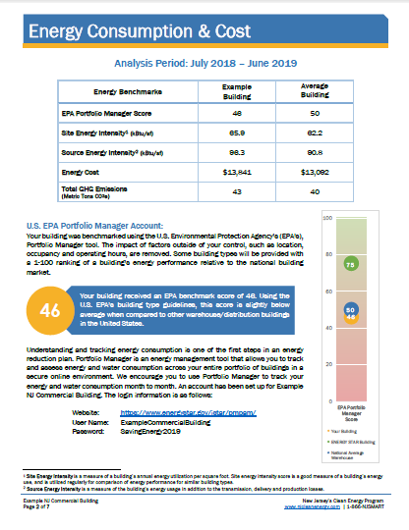
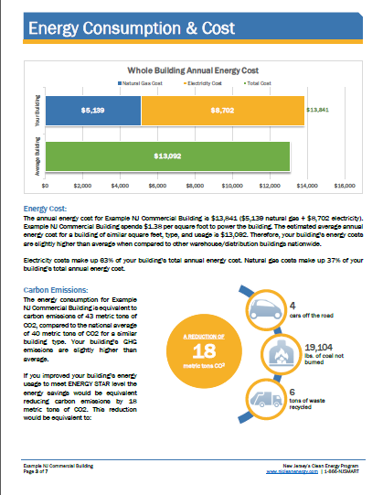
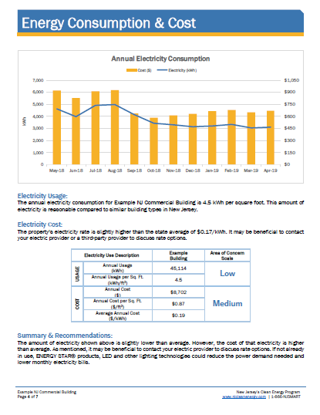
Benchmarking
Measurement & AUDITS
NJCleanEnergy.com/BENCHMARKING

Slide 11
Local Government Energy Audit
Measurement & AUDITS
NJCleanEnergy.com/LGEA
WHO
Local Government, New Jersey Colleges and Universities, and 501(c)(3) Non-Profit buildings with an average yearly demand >200kW*
Includes Benchmarking
Cost
Free
WhY
Inventory of all energy-consuming equipment and line by line program eligibility, savings and costs
Comprehensive utility bill analysis
Facility benchmarking
Feasibility for solar and combined heat & power
INCENTIVE CAP
$100,000 per entity (covers most small to large entities)
$300,000 per 501(c)(3) hospital
$300,000 per entity interested in ESIP
* Inquire about the waivers available to buildings ≤200kW average

Slide 12
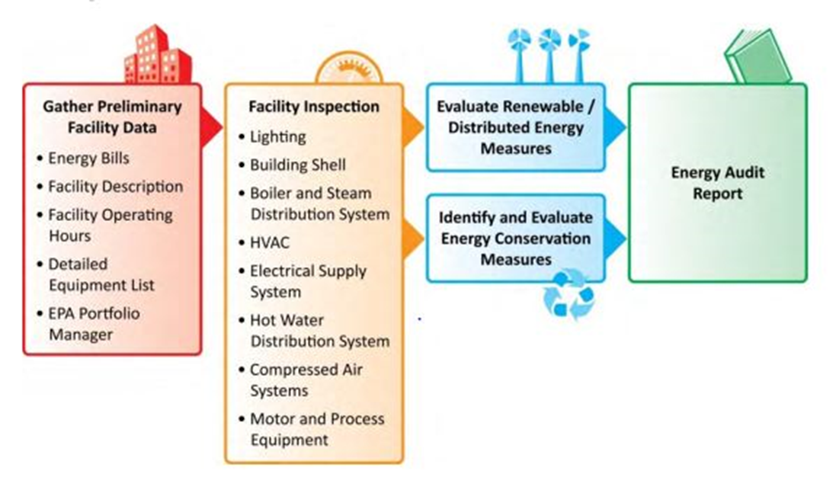
Local Government Energy Audit
Measurement & AUDITS
NJCleanEnergy.com/LGEA

Slide 13
C&I Portfolio of Programs
Eligible Sectors: Commercial, Industrial, Government, Schools, Non-Profit, Institutional and Multifamily
Measurement & AUDITS
COMPREHENSIVE PROGRAMS
SINGLE MEASURE REBATES
DISTRIBUTED ENERGY RESOURCES
Energy Benchmarking
Local Government Energy Audits (for non-profits too)
Multifamily*
Single Measure
Multi-measure
Large Energy Users
Pay for Performance
Existing Buildings
New Construction
Direct Install
Customer Tailored Energy Efficiency Pilot
SmartStart
Existing Buildings
New Construction
Combined Heat & Power - Fuel Cells
Microgrid Development
Battery Storage*
Electric Vehicles*
* coming soon!
Notes:
Order of programs discussed is from larger to smaller in building size

Slide 14
Coming Soon!
Multifamily
Comprehensive
Programs
NJCleanEnergy.com/MULTIFAMILY
WHO
Multifamily owner, developer, management company, or homeowners association with five or more dwellings
where
In-unit, common area, and exterior area upgrades
ABOUT
A single point of entry for all eligible multifamily premises applying for incentives through the NJCEP portfolio
New construction and existing buildings
Flexibility to do a single-measure or multi-measure bundle
INCENTIVE CAP
Increased incentives and caps for UEZs, affordable MF housing, and local governments

Slide 15
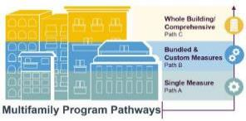
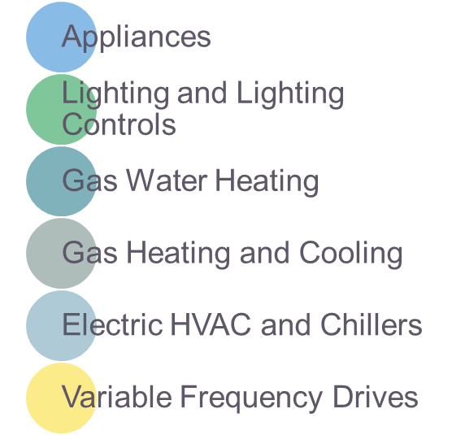
Coming Soon!
Multifamily
Comprehensive
Programs
NJCleanEnergy.com/MULTIFAMILY
PATH A
PATH B
PATH C
Single measure
Bundled & Custom measures
Whole Building / comprehensive
Simple, prescriptive rebates for the most popular building technologies, such as:
10% bonus incentives for bundled technologies
Custom incentives for non-standard or emerging technologies
Incentives are based on energy savings demonstrated via comprehensive energy modeling
Projects with higher energy savings are rewarded with higher incentives

Slide 16
Large Energy Users
Comprehensive
Programs
NJCleanEnergy.com/LEUP
WHO
Large C&I entities who have paid a minimum of $200,000 NJCEP funds (via the SBC) in the previous 12 months of utility bills
SIZE TO QUALIFY
The average peak demand of all facilities submitted ≥400kW and/or 4,000 DTh
ABOUT
Encourages large C&I utility customers to self-invest in energy efficiency, combined heat & power, and fuel cell projects
Must have ability to “bank” funds for up to two fiscal years
INCENTIVE CAP
Maximum incentive per entity is the lesser of:
$4 million,
75% of total project cost, or
90% of NJCEP contribution or annual energy saving caps ($0.33/kWh and $3.75/therm)

Slide 17
Large Energy Users
Comprehensive
Programs
NJCleanEnergy.com/LEUP
Program Enrollment
Submission and Approval of Application
Submission of Draft Energy Efficiency Plan Reservation of Incentives (optional)
Submission of Final Energy Efficiency Plan Commitment of Incentives
Confirmation of Installation
Incentives Paid

Slide 18
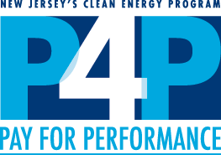
Pay for Performance
Comprehensive
Programs
NJCleanEnergy.com/P4P
WHO
Large C&I existing buildings or new construction seeking two or more energy efficiency measures with a minimum 15% savings
SIZE TO QUALIFY
Annual peak demand 200+ kW in the previous year for existing buildings or over 50,000 square feet of planned new construction
ABOUT
A pre-approved Participating Partner will streamline the program and guide users through the program phases
Incentive CAP
50% of project cost (or 80% for UEZ/OZ/Local Gov/K-12 Public Schools) up to $2M per project / $4M per entity annually
Incentive payments #2 and #3 are doubled for UEZ/OZ/Local Gov/K-12 Public Schools

Slide 19
Pay for Performance
Comprehensive
Programs
NJCleanEnergy.com/P4P
1 year
Program Enrollment
Submission and Approval of Application
Energy Reduction Plan (ERP)
Development and Approval
Installation of Measures
Installation Verification Report
Verification of Savings
Comparison of Performance vs ERP
Incentive #1
fixed
Incentive #2
up to 25%
project cost
Incentive #3
up to 25%
project cost
Incentive #2
up to 40%
project cost
Enhanced incentives to buildings in UEZ/OZ/local gov/K-12 public schools
Incentive #3
up to 40%
project cost
Notes:
2-3 years to complete the process (plan for 3 years)
Installation Verification Report:
NC: As-Built ERP
EB: Installation Report

Slide 20
Direct Install
Comprehensive
Programs
NJCleanEnergy.com/DI
WHO
Small to medium sized C&I existing facilities seeking to replace inefficient equipment
SIZE TO QUALIFY
Average annual peak demand <200 kW in the previous 12 months
ABOUT
A pre-approved regional Participating Contractor will do a walk-through evaluation and guide users through the program phases
Turn-key process with fast project turnaround time
INCENTIVE CAP
$125,000 incentive funding per project/building ($250K UEZ/OZ/ Local Gov/K-12 Public Schools), or
$250,000 per entity ($500K ESIP; $4M UEZ/OZ/Local Gov/K-12 Public Schools)

Slide 21
Direct Install
Comprehensive
Programs
NJCleanEnergy.com/DI
Facilities in Urban Enterprise Zones (UEZ), Opportunity Zones (OZ), local governments, and K-12 public schools:
INCENTIVE FUNDING
Up to 80% of installed cost is paid directly to the contractor
CUSTOMER
20% of installed cost
All other eligible facilities:
INCENTIVE FUNDING
Up to 70% of installed cost is paid directly to the contractor
CUSTOMER
30% of installed cost

Slide 22
Customer Tailored
Energy Efficiency Pilot
Comprehensive
Programs
NJCleanEnergy.com/CTEEP
WHO
C&I customers seeking a streamlined/single application for participants submitting for multiple different technology types
SIZE TO QUALIFY
N/A
ABOUT
On site assistance available
One application form for multiple prescriptive or custom measures
Utilizes SmartStart Incentives
Additional technical incentive available to offset soft costs associated with developing and planning custom projects
INCENTIVE CAP
Maximum incentive per entity is the lesser of:
$250,000 entity cap,
50% of eligible project costs, or
Buy-down to 1-year payback
Up to $10,000 for technical assistance of custom project evaluation
Same incentive values as SmartStart

Slide 23
Customer Tailored
Energy Efficiency Pilot
Comprehensive
Programs
NJCleanEnergy.com/CTEEP
Payment schedule based on program variation:
Energy Efficiency Plan Approval
Installation Complete
Performance Verification
Technical Assistance (Optional)
50%
50%
CTEEP Prescriptive Measures
100%
CTEEP Custom Measures
90%
10%

Slide 24
C&I Portfolio of Programs
Eligible Sectors: Commercial, Industrial, Government, Schools, Non-Profit, Institutional and Multifamily
MEASTUREMENT & AUDITS
COMPREHENSIVE PROGRAMS
SINGLE MEASURE REBATES
DISTRIBUTED ENERGY RESOURCES
Energy Benchmarking
Local Government Energy Audits (for non-profits too)
Multifamily*
Single Measure
Multi-measure
Large Energy Users
Pay for Performance
Existing Buildings
New Construction
Direct Install
Customer Tailored Energy Efficiency Pilot
SmartStart
Existing Buildings
New Construction
Combined Heat & Power - Fuel Cells
Microgrid Development
Battery Storage*
Electric Vehicles*
* coming soon!

Slide 25
SmartStart
SINGLE MEASURE
rebates
NJCleanEnergy.com/SSB
WHO
All C&I: Commercial, Industrial, Agricultural, Government, Non-Profit and Institutional customers
SIZE TO QUALIFY
N/A
ABOUT
Individual high efficiency equipment rebates for new construction, renovation, remodeling, equipment replacement
Prescriptive and custom designed measures
Pre-approval required for lighting ≥ $100,000 and all custom measures
INCENTIVE CAP
Prescriptive: $500,000 for each electric or gas account
Custom, lesser of the following:
$0.16/kWh and/or $1.60/therm saved annually;
50% of incremental installed cost; and
Buy-down to 1 year payback based on incremental cost and savings

Slide 26
SmartStart
SINGLE MEASURE
rebates
NJCleanEnergy.com/SSB
Prescriptive Incentives
Custom Incentives
Lighting & Lighting Controls
Packaged HVAC
Boilers & Water Heaters
Chillers
VFDs
Food Service
Refrigeration
New or innovative technologies proven to be cost-effective and not listed as prescriptive
Projects must have a minimum first year energy savings of 75,000 kWh or 1,500 therms
Project pre and post inspection required
Existing buildings prescriptive only:
Double incentives for OZ/UEZ/Local Gov/ K-12 Public schools

Slide 27
C&I Buildings
Coming Soon!
During the coming year, several programs will be transitioned to one primary program designed to better facilitate energy efficiency for New Jersey customers:
SmartStart (EB & NC)
CTEEP
Pay for Performance (EB & NC)
Large Energy Users
C&I Buildings
Local Government Energy Audit
Direct Install
Combined Heat and Power – Fuel Cells

Slide 28
C&I Buildings
Coming Soon!
NJ BASE
PATH A
PATH B
PATH C
NJBASE:
Building & Systems Evaluation
Single measure prescriptive
Multi measure & Custom
Whole Building
Optional first step before upgrade paths
Building-specific technical assistance to guide decision making
50/50 cost-share model
Done by pre-approved contractors
Rebate structure
Simplified application, equipment categories, and requirements
Progress payments for completion of energy conservation measures
Bonus incentives for bundles
No minimum savings for Custom
Simplified requirements
No minimum size or savings required, but comprehensive scope of work required
Performance Incentive for Optional M&V
Pre-approved contractors

Slide 29
C&I Portfolio of Programs
Eligible Sectors: Commercial, Industrial, Government, Schools, Non-Profit, Institutional and Multifamily
FIRST ½ FY20
MEASUREMENT & AUDITS
COMPREHENSIVE PROGRAMS
SINGLE MEASURE REBATES
DISTRIBUTED ENERGY RESOURCES
Energy Benchmarking
Local Government Energy Audits (for non-profits too)
Multifamily*
Single Measure
Multi-measure
Large Energy Users
Pay for Performance
Existing Buildings
New Construction
Direct Install
Customer Tailored Energy Efficiency Pilot
SmartStart
Existing Buildings
New Construction
Combined Heat & Power - Fuel Cells
Microgrid Development
Battery Storage*
Electric Vehicles*
* coming soon!

Slide 30
Combined Heat & Power - Fuel Cells
distributed
energy
NJCleanEnergy.com/CHP
WHO
C&I customers that require on-site electric generation that either does or does not utilize waste heat
SIZE TO QUALIFY
N/A - Projects must pass a cost-effectiveness test and run 5,000 full load equivalent hours per year (3,500 for critical facilities)
ABOUT
Combined Heat & Power (CHP) units generates electricity and recycle waste heat to provide heating or cooling
Resiliency with return on investment
Technology-neutral incentives
Fuel Cells (FC) with or without heat recovery (HR)
INCENTIVE
Levels
CHPs and FC with HR have a project cap of $2MM - $3MM
25% bonus for critical facilities with black-start/islanding capabilities
Up to 30% incentive bonus for CHP using biofuel
FC without HR have a project cap of $1MM

Slide 31
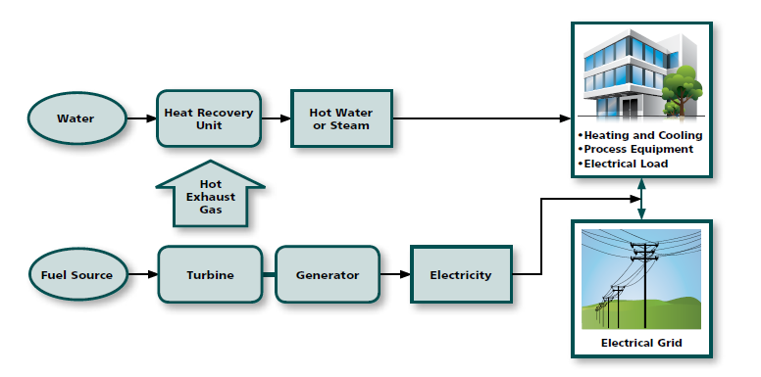
Combined Heat & Power
distributed
energy
NJCleanEnergy.com/CHP

Slide 32
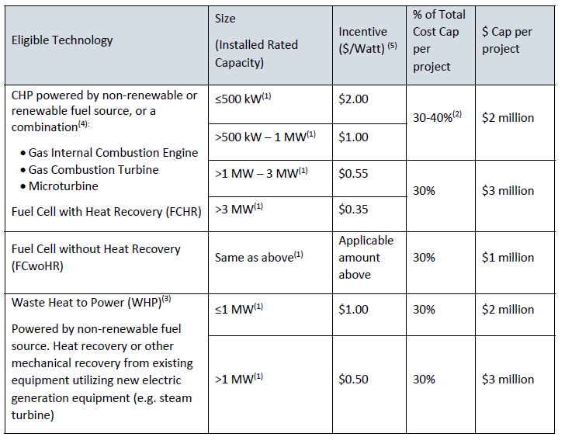
Combined Heat & Power - Fuel Cells
distributed
energy
NJCleanEnergy.com/CHP
+critical facility/blackstart bonus of 25%

Slide 33
Microgrids
distributed
energy
NJBPU Town Center Distributed Energy Resources (TCDER) Microgrids Program
TCDER Microgrid is a cluster of critical facilities within a municipal boundary that may also operate as shelter for the public during and after an emergency event or provide services that are essential to function during and after an emergency situation. These critical facilities are connected to a single or series of DER technologies that can operate while isolated and islanded from the main grid due to a power outage
Board funded 13 feasibility studies
Feasibility studies completed and being reviewed

Slide 34
Microgrids
distributed
energy
EDCs fully engaged in program
Barriers to TCDER Microgrids
Regulatory
ROW crossings
Tariff structures
Funding
To address funding issue, Board, with NJIT and Rutgers, received DOE Grant of $300,000 for a microgrid financing study
Result will be a public “financing tool” for use by microgrid developers
Study to begin this month, completed within 2 years

Slide 35
Battery Storage
distributed
energy
FIRST ½ FY20
Commitment to Resiliency
The Clean Energy Act also requires the Board to conduct an Energy Storage Resource analysis for submission to the Governor and the Legislature. In doing so, the Board is required by law to consult with various stakeholders, including PJM
Rutgers (RU-LESS) is retained to complete the study
Study to address:
Resiliency
Effects on ratepayers
Impacts on renewable energy and EVs
Optimal amount of storage
Technologies
Optimal points of entry (customer sited, utility scale)
Cost-benefit

Slide 36
Battery Storage
distributed
energy
Final report accepted by the Board in June 2019
CEA requires Board to initiate a proceeding within six months of completion of report to establish a process and mechanism for achieving energy storage goals

Slide 37
Electric Vehicle (EV) Overview
distributed
energy
In June 2019, Governor Murphy signed an MOU outlining the BPU’s role in encouraging Electric Vehicle use in New Jersey
BPU will consider how to utilize CEP funds to finance ZEV charging infrastructure deployment & mapping
BPU will consider how to dedicate CEP funds to create a rebate program to incentivize sale of new and used ZEVs
BPU will track usage and electric consumption from charging infrastructure

Slide 38
EVs for Underserved Communities
distributed
energy
Grant from the US Department of Energy
Focused on how to enhance EV adoption in urban areas and in underserved communities
Look at EV car sharing options and PEV-based ride hailing

Slide 39
EVs in the Energy Master Plan Draft
distributed
energy
First strategy and goal is to “Reduce Consumption and Emissions from the Transportation Section”
2025 – 330,000 light duty electric vehicles
Charging infrastructure
State light-duty fleet
Increase transportation options, encourage new options
Decrease Vehicle Miles Traveled
Port emissions

Slide 40
Financing for government agencies

Slide 41
Financing Mechanism: ESIP
Energy Savings Improvement Program (ESIP)
Provides alternative financing for energy savings projects at public institutions
Administered directly by the BPU
Value of energy savings leveraged to pay for cost of EE projects over a 15 year contract
Requires NO new bonding and is outside of capital budget
Does not count as debt or require voter approval

Slide 42
Financing Mechanism: ESIP
Initial Energy Audit
Includes LGEA
Select Path
ESCO (requires RFP)
Hybrid
DIY
Investment Grade Energy Audit
Energy Savings Plan Developed & Approved
Plan includes use of incentives through New Jersey’s Clean Energy Program

Slide 43
More Information

Slide 44
Clean Energy Learning Center
NJCELC.com
Online education tool – courses and videos
Audience is building owners and managers, design professionals, energy professionals, contractors, builders, code officials, homeowners and NJCEP representatives

Slide 45
More Information
Visit
NJCleanEnergy.com
CONTACT
(866) 657-6278
Outreach@NJCleanEnergy.com
Newsletter
NJCleanEnergy.com/NEWSLETTER
ListservS
NJCleanEnergy.com/LISTSERVS
@NJCleanEnergy
Notes:
[use this slide or the slide that follows]

